Slide 1
DEVELOPMENT OF AN INTEGRATED CATCHMENT MANAGEMENT PLAN FOR Pyeng, PLATEAU STATE
Kehinde Ogunmola, PhD
NCRS CONSULT

Slide 2
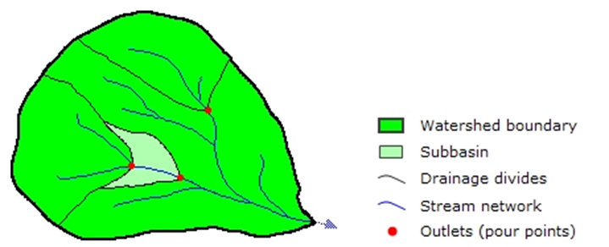
INTRODUCTION
The Pyeng Catchment is urban and characterized by abandoned mine ponds and a few active artisanal mining which requires explicit consideration of uncertainties about the sources of water pollution. Parts of River Kaduna also passes through this catchment and the problem of encroachment into flood plains due to urbanization is common.
A watershed/catchment is the upslope area that contributes flow—generally water—to a common outlet as concentrated drainage. It can be part of a larger watershed and can also contain smaller watersheds, called subbasins. The boundaries between watersheds are termed drainage divides. The outlet, or pour point, is the point on the surface at which water flows out of an area. It is the lowest point along the boundary of a watershed.

Slide 3
An urban catchment has diverse benefits associated with it - economic, natural, recreational, and cultural - with natural systems within the catchment having to absorb a number of uses associated with these benefits.
Soil erosion also poses a threat to watersheds and the environment. According to the FAO, the world's cultivated soils - meaning soils that have been rearranged - have lost between 25 and 75 percent of their original carbon stock, which has been released into the atmosphere in the form of carbon dioxide.
Research reports (Igbokwe et al., 2008; Jimoh, 2008; Abu, 2011) have established relationships between human activities and soil erosion, indicating that both affect each other significantly.

Slide 4
Erosion is one of the physical manifestations of environmental degradation, which can be facilitated by causative factors of wind and water. However, the most prominent of these factors is soil erosion by water, and its rate and magnitude are controlled by the factors of rainfall intensity and run-off, soil erodibility, slope gradient and length, and vegetation cover (Wall et al., 1987).
The performance of watersheds and their ecosystem are being threatened by the emergence of global warming and climate change. This has caused increase in pattern of precipitation, runoff, erosion, siltation and pollution etc.
According to Giddens (2008), climate change has moved to the center stage of public concern in a remarkable way and in a very short space of time.

Slide 5
Rational For an Integrated Catchment Management Plan Approach
The model adopted for generating a catchment management Plan for Pyeng catchment is a participatory approach based on an open stakeholder engagement that enables all those with an interest in the catchment to interact and work effectively together so as to achieve resource sustainability, deliver improvements to the catchment and ensure future access to natural resources to all that depend on the catchment and overall promote development.
A well-integrated Management Plan is aimed at balancing the use of land, biological and water resources within a catchment, in a sustainable way, by promoting co-operation and co-ordination at all levels of Government, in collaboration with the entire community on management of these resources (Bunn and Mouritz, 1995).

Slide 6
The primary aim of an ICMP is to show how a catchment will be sustainably managed and protected, how devastated areas can be reclaimed or how to slow down the environmental menace and eventually put an end to it.
Catchments are independent of political and administrative boundaries and consist of natural and human modified ecosystems with a characteristic configuration of topography, geology, soils, land use and vegetation.
This approach is ‘Integrated’ because the ICMP integrates or combines characteristics such as ecology, hydrology, landuse, engineering, public health, socio-economic characteristics, indigenous knowledge and expectations of the people. The ‘catchment’ approach makes sure that the combined effects emanating from all the activities within the catchment are reflected in the plan.

Slide 7
Objectives of the ICMP
Delineate the catchment using a digital elevation model (DEM).
Describe the existing status of the catchments
Identify the environmental and social issues/risks associated with the existing conditions
Develop a plan for mitigating environmental and social risks
Define technical assistance programs that could strengthen environmental management capability
Provide an implementation schedule for measures that must be carried out
Provide a synoptic view of the current state of each catchment.

Slide 8
Threats to address
Managing high surface water run-off
Soil erosion
Poor waste management practices that can contribute to clogging of drains, flooding, and land degradation
Inappropriate land uses contributing to sedimentation, flooding and land degradation
High poverty rates, especially among women and vulnerable groups
Adverse impact of climate change on the environment
Lack of Community Education and Awareness
Habitat Destruction and Fragmentation
Water pollution

Slide 9
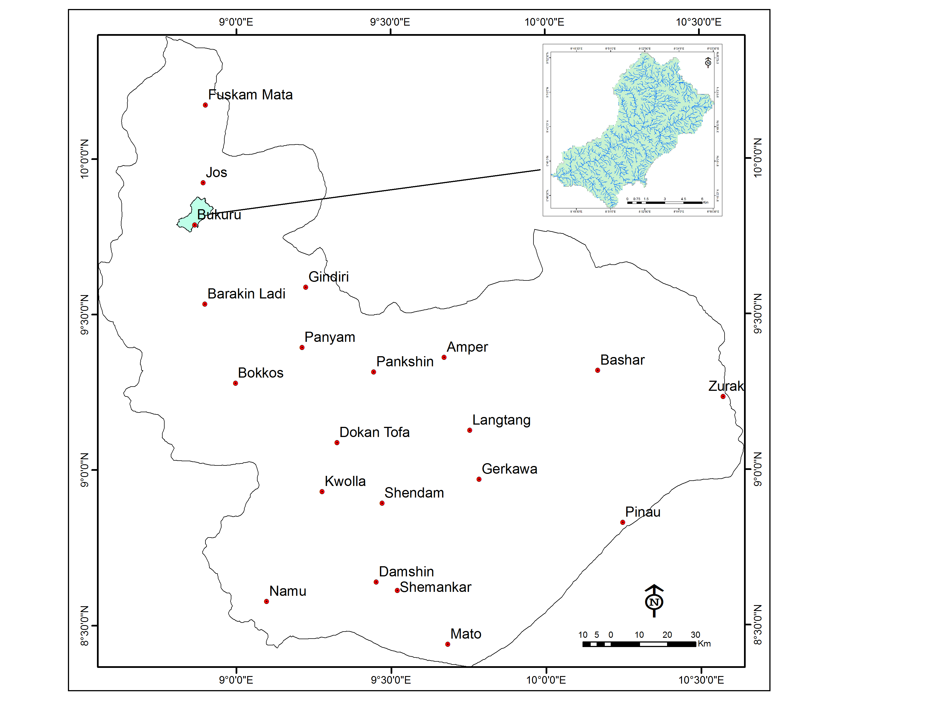
Location of the Catchment
The catchment is located in the northern part of Plateau State (fig 1).
Figure 1. Map of Plateau State
(inset: Pyeng Catchment)

Slide 10
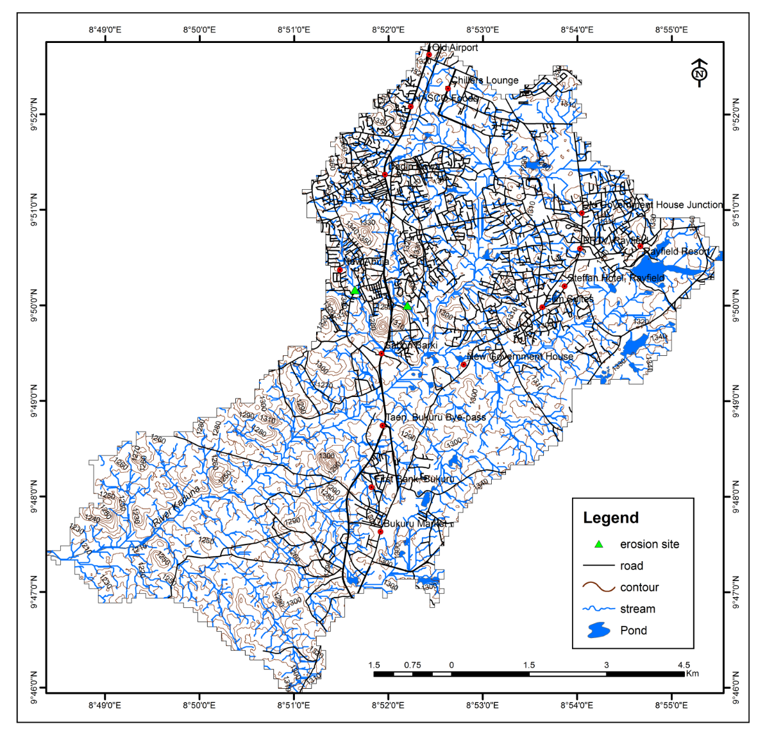
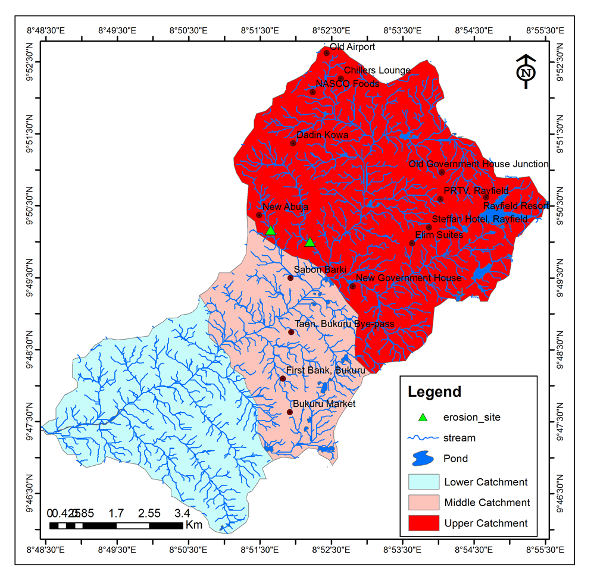
Description of the catchment
The catchment is an urban catchment. It is bounded by the following coordinates with a perimeter of about 60 km and an area of about 7044 Hectares (fig 2). It is located in Jos South LGA of Plateau State.
Figure 2. Topographic map of the Pyeng Catchment
Figure 3. Sub-divisions of the Pyeng Catchment

Slide 11
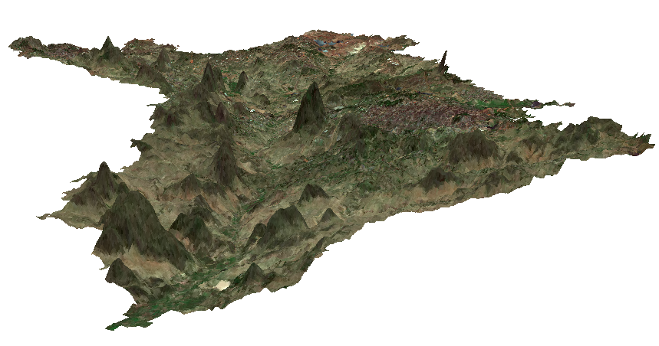
River Kaduna
Hills
Figure 4. 3D view of the Pyeng Catchment

Slide 12
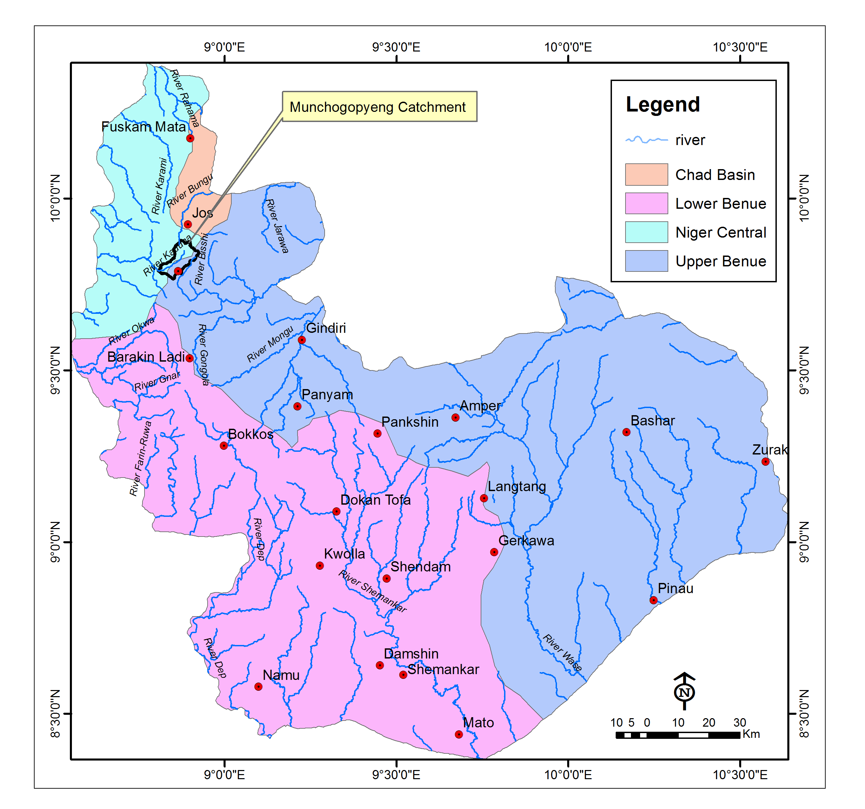
Hydrology
Plateau State falls within four (4) Hydrological areas namely HA-8: Chad Basin., HA-4: Lower Benue, HA-2: Niger Central and HA-3: Upper Benue. Pyeng Catchment falls within HA-3: Upper Benue and HA-2: Niger Central Hydrological areas (fig 5).
Figure 5. Hydrological Map of Plateau State showing the location of the Pyeng Catchment (source: JICA, 2014)

Slide 13
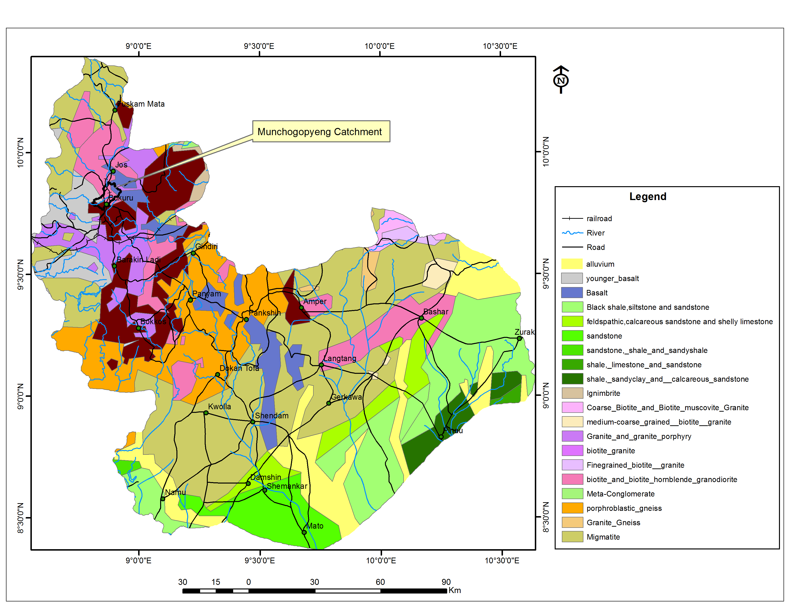
Geology
Figure 6. Geological map of
Plateau State showing the
Pyeng catchment

Slide 14
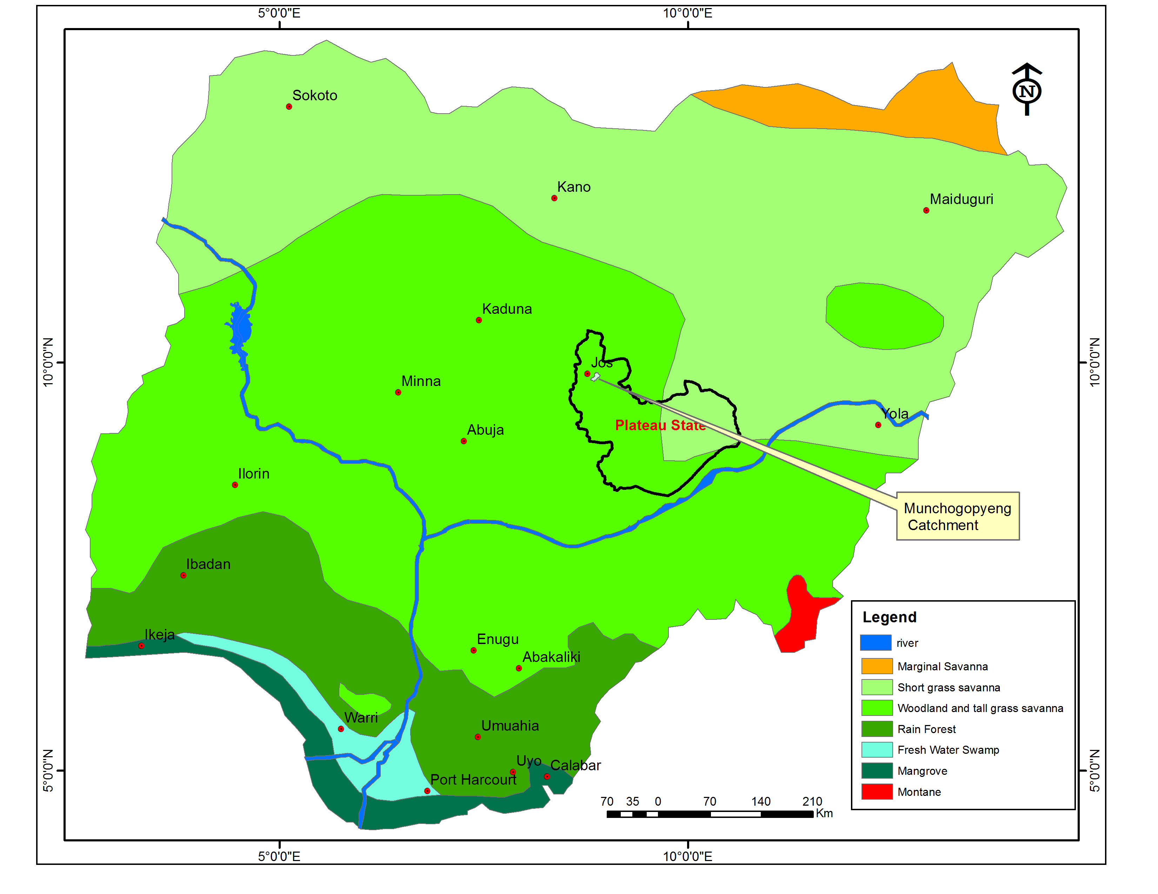
Vegetation
Figure 7. Vegetation map of Nigeria showing
Plateau State and the location of the catchment
(source: Public domain)

Slide 15
Bacterial Water Quality
S/N | SAMPLE ID | LOCATION | CATCHMENT | COORD (N) | COORD | PLATE COUNT | BACTERIAL COUNT
1 | MCH 01 | BUKURU LOWCOST STREAM | LOWER | 9.8140278 | 8.860555556 | 86 | 92
2 | MCH 02 | WITT STERAM | LOWER | 9.8185 | 8.86725 | 91 | 86
3 | MCH 03 | RAT CONFLUENCE | LOWER | 9.8222778 | 8.870805556 | 89 | 71
4 | MCH 04 | RAT HAND DUG WELL | LOWER | 9.8220556 | 8.869611111 | 78 | 44
5 | MCH 05 | Pyeng STREAM | MIDDLE | 9.8273333 | 8.873944444 | 81 | 72
6 | MCH 06 | LAYON STREAM | MIDDLE | 9.8348333 | 8.868083333 | 89 | 63
7 | MCH 07 | ZARMAGANDA STREAM | MIDDLE | 9.847 | 8.866611111 | 99 | 54
8 | MCH 08 | ZUMJI STREAM, SABON BARKI JUNCTION | MIDDLE | 9.8254167 | 8.866416667 | 93 | 61
9 | MCH 09 | BUILDING MATERIAL STREAM (LOMAY) | UPPER | 9.8304444 | 8.863277778 | 98 | 72
10 | MCH 10 | BUILDING MATERIAL STREAM (OPEN UNIVERSITY) | UPPER | 9.8358889 | 8.860888889 | 72 | 39
 | WHO/NSDWQ |  |  |  |  |  | 0/10
Table 1. Plate and Coliform count
in waters of Pyeng
Catchment Area

Slide 16
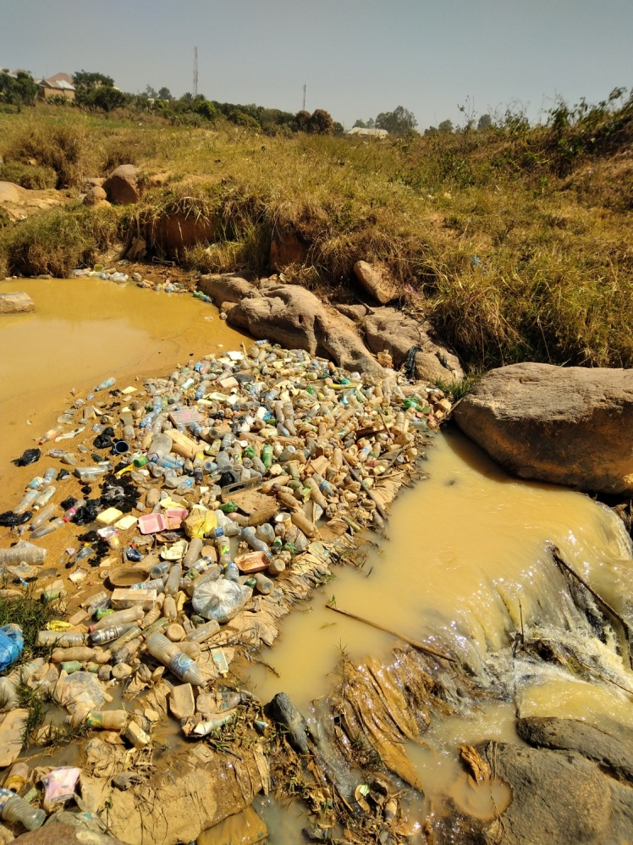
Plate 1. Plastic bottles, polyethene bags and rags within one of the Pyeng streams. Open defecation is a common practice along the channel.

Slide 17
Table 2. Isolated micro-organisms in water samples
 |  |  |  |  |  |  |  |  | Triple Sugar Ion Agar Slant
Sample No. | Catchment | Catalase | Coagulase | Indole | Urease | Oxidase | Citrate | Motility | Slope | Butt | H₂₅ | Gas | Microorganism Isolated from the Samples
MCH 01 | LOWER | + | + | + | - | - | + | - | y | Y | - | + | Staphylococcus aureus Escherichia coli,
MCH 02 | LOWER | - | - | + | + | - | + | - | Y | Y | - | + | Escherichia coli, Proteus spp
MCH 03 | LOWER | - | - | + | + | - | + | - | Y | Y | - | + | Escherichia coli, Proteus spp
MCH 04 | LOWER | + | + | + | - | - | + | - | Y | Y | - | + | Staphylococcus aureus, Escherichia coli,
MCH 05 | MIDDLE | - | - | + | + | - | - | - | Y | Y | - | + | Escherichia coli, Proteus spp
MCH 06 | MIDDLE | + | + | + | - | - | + | - | Y | Y | - | + | Staphylococcus aureus, Escherichia coli,
MCH 07 | MIDDLE | + | - | + | - | - | + | - | Y | Y | + | + | Streptococcus faecalis, Escherichia coli, Salmonella typhi.
MCH 08 | MIDDLE | + | + | - | + | - | + | - | r | Y | - | - | Staphylococcus aureus, Proteus spp
MCH 09 | UPPER | + | + | + | + | - | + | - | Y | Y | - | + | Staphylococcus aureus, Escherichia coli, Proteus spp
MCH 10 | UPPER | + | + | + | - | - | + | - | Y | Y | - | + | Staphylococcus aureus, Escherichia coli,

Slide 18
Physical and Chemical Quality of Water Samples
Table 3. Physico-Chemical Parameters of water samples
S/N | SAMPLE ID | LOCATION | CATCHMENT | COORD (N) | COORD (E) | COLOUR | ODOUR | TEMP | PH | TDS | EC | Na | Ca | Mg | K | Cl | NO₃ | SO₄ | ALK
1 | MCH 01 | BUKURU LOWCOST STREAM | LOWER | 9.81402778 | 8.860555556 | cloudy | odourless | 22.5 | 7.55 | 36 | 72 | 7.8 | 7.15 | 1.33 | 4.59 | 20 | 13.2 | 20.8 | 40
2 | MCH 02 | WITT STERAM | LOWER | 9.8185 | 8.86725 | cloudy | odourless | 21.2 | 7.5 | 47 | 94 | 8.58 | 6.44 | 1.85 | 4.64 | 20 | 8.8 | 20 | 40
3 | MCH 03 | RAT CONFLUENCE | LOWER | 9.82227778 | 8.870805556 | partly cloudy | odourless | 22.6 | 7.6 | 39 | 78 | 7.77 | 6.57 | 1.18 | 4.21 | 20 | 6.6 | 17 | 40
4 | MCH 04 | RAT HAND DUG WELL | LOWER | 9.82205556 | 8.869611111 | colourless | odourless | 25.8 | 5.3 | 27 | 54 | 7.7 | 5.85 | 1.08 | 4.42 | 15 | 22 | 2.9 | 5
5 | MCH 05 | PYENG STREAM | MIDDLE | 9.82733333 | 8.873944444 | colourless | odourless | 23.2 | 7.66 | 56 | 112 | 10.2 | 7.1 | 1.37 | 5.01 | 20 | 17.6 | 8.5 | 40
6 | MCH 06 | LAYON STREAM | MIDDLE | 9.83483333 | 8.868083333 | colourless | odourless | 27.8 | 7.61 | 103 | 206 | 12.7 | 9.75 | 2.06 | 7.01 | 25 | 17.6 | 3.8 | 75
7 | MCH 07 | ZARMAGANDA STREAM | MIDDLE | 9.847 | 8.866611111 | colourless | odourless | 25.5 | 7.44 | 106 | 212 |  |  |  |  | 30 | 8.8 | 4.9 | 90
8 | MCH 08 | ZUMJI STREAM, SABON BARKI JUNCTION | MIDDLE | 9.82541667 | 8.866416667 | colourless | odourless | 26.3 | 7.92 | 41 | 82 |  |  |  |  | 20 | 8.8 | 7.5 | 25
9 | MCH 09 | BUILDING MATERIAL STREAM (LOMAY) | UPPER | 9.83044444 | 8.863277778 | colourless | odourless | 26.8 | 7.01 | 35 | 70 |  |  |  |  | 15 | 26.4 | 5.7 | 20
10 | MCH 10 | BUILDING MATERIAL STREAM (OPEN UNIVERSITY) | UPPER | 9.83588889 | 8.860888889 | colourless | odourless | 27.2 | 6.81 | 41 | 82 |  |  |  |  | 20 | 8.8 | 3.8 | 30
 |  | WHO*/NSDWQ |  |  |  | Unobjectionable | Unobjectionable | Ambient | 6.5 - 8.5 | 500 | 1000 | 200 |  |  |  |  | 50 | 100

Slide 19
Table 4. Trace Element Concentration in Water Samples
S/N | SAMPLE ID | LOCATION | CATCHMENT | COORD (N) | COORD (E) | Al | Ba | Bi | Be | Cd | Co | Cr | Cu | Fe | Mn | Ni | Pb | Sr | Ti | V | Zn
1 | MCH 01 | BUKURU LOWCOST STREAM | Lower | 9.814027778 | 8.860555556 | 0.15 | 0.02 | 0.34 | ND | 0.52 | 0.01 | 0.02 | ND | 0.08 | 0.05 | 0.1 | ND | 0.04 | 0.02 | 0.15 | 0.03
2 | MCH 02 | WITT STERAM | Lower | 9.8185 | 8.86725 | 0.12 | 0.62 | 0.34 | ND | 0.54 | 0.01 | 0.03 | 0.05 | 0.08 | 0.04 | 0.12 | 0.01 | 0.04 | 0.03 | 0.14 | 0.03
3 | MCH 03 | RAT CONFLUENCE | Lower | 9.822277778 | 8.870805556 | 0.12 | 0.01 | 0.34 | ND | 0.52 | 0.01 | 0.02 | 0.01 | 0.03 | 0.04 | 0.13 | ND | 0.03 | 0.03 | 0.14 | 0.03
4 | MCH 04 | RAT HAND DUG WELL | Lower | 9.822055556 | 8.869611111 | 0.15 | 0.04 | 0.32 | ND | 0.49 | 0.02 | 0.02 | ND | 0.05 | 0.03 | 0.13 | ND | 0.03 | 0.04 | 0.16 | 0.02
5 | MCH 05 | Pyeng STREAM | Middle | 9.827333333 | 8.873944444 | 0.09 | 0.02 | 0.29 | ND | 0.45 | 0.02 | 0.03 | 0.01 | 0.28 | 0.02 | 0.13 | ND | 0.04 | 0.04 | 0.14 | 0.03
6 | MCH 06 | LAYON STREAM | Middle | 9.834833333 | 8.868083333 | 0.11 | 0.54 | 0.27 | ND | 0.37 | 0.02 | 0.03 | 0.02 | 0.23 | 0.02 | 0.12 | ND | 0.06 | 0.05 | 0.15 | 0.05
 |  | WHO/NSDWQ |  |  |  | 0.20 | 0.70 |  |  | 0.003 |  |  | 1.00 | 0.30 | 0.20 | 0.02 | 0.01 |  |  |  | 3.00
The trace elements cadmium and nickel exceed the WHO recommended limits of 0.003ppm and 0.07ppm in all the samples

Slide 20
Irrigation and Livestock Water Quality in Pyeng Catchment
Table 5. Irrigation water quality for some selected areas
S/N | SAMPLE ID | LOCATION | COORD (N) | COORD (E) | SALINITY HAZARD | SAR | ESR | MAGNESIUM HAZARD
1 | MCH 01 | BUKURU LOWCOST STREAM | 9.81403 | 8.86056 | LOW | 0.007 | 0.728 | 23.5
2 | MCH 02 | WITT STREAM | 9.8185 | 8.86725 | LOW | 0.008 | 0.788 | 32.1
3 | MCH 03 | RAT CONFLUENCE | 9.82228 | 8.87081 | LOW | 0.007 | 0.795 | 22.8
4 | MCH 04 | RAT HAND DUG WELL | 9.82206 | 8.86961 | LOW | 0.080 | 0.880 | 23.3
5 | MCH 05 | Pyeng STREAM | 9.82733 | 8.87394 | LOW | 0.100 | 1.000 | 24.1
6 | MCH 06 | LAYON STREAM | 9.83483 | 8.86808 | LOW | 0.001 | 0.841 | 25.8
The salinity hazards in all the waters are low and so are Sodium Absorption Ratio, Exchangeable Sodium Ratio and Magnesium Hazard.

Slide 21
Soil Classification, Description and Capability
Land Capability Classification of the catchment area are follows:
Class III: This class has the following attributes:
  High susceptibility to water erosion
  Low water holding capacity
  Low soil fertility not easily corrected
Class V to VIII: This consist of a complex of land types with the following attributes:
  Low water holding capacity
  Steep slopes
  Gully erosion
  Shallow rooting zone
  Mining activities

Slide 22
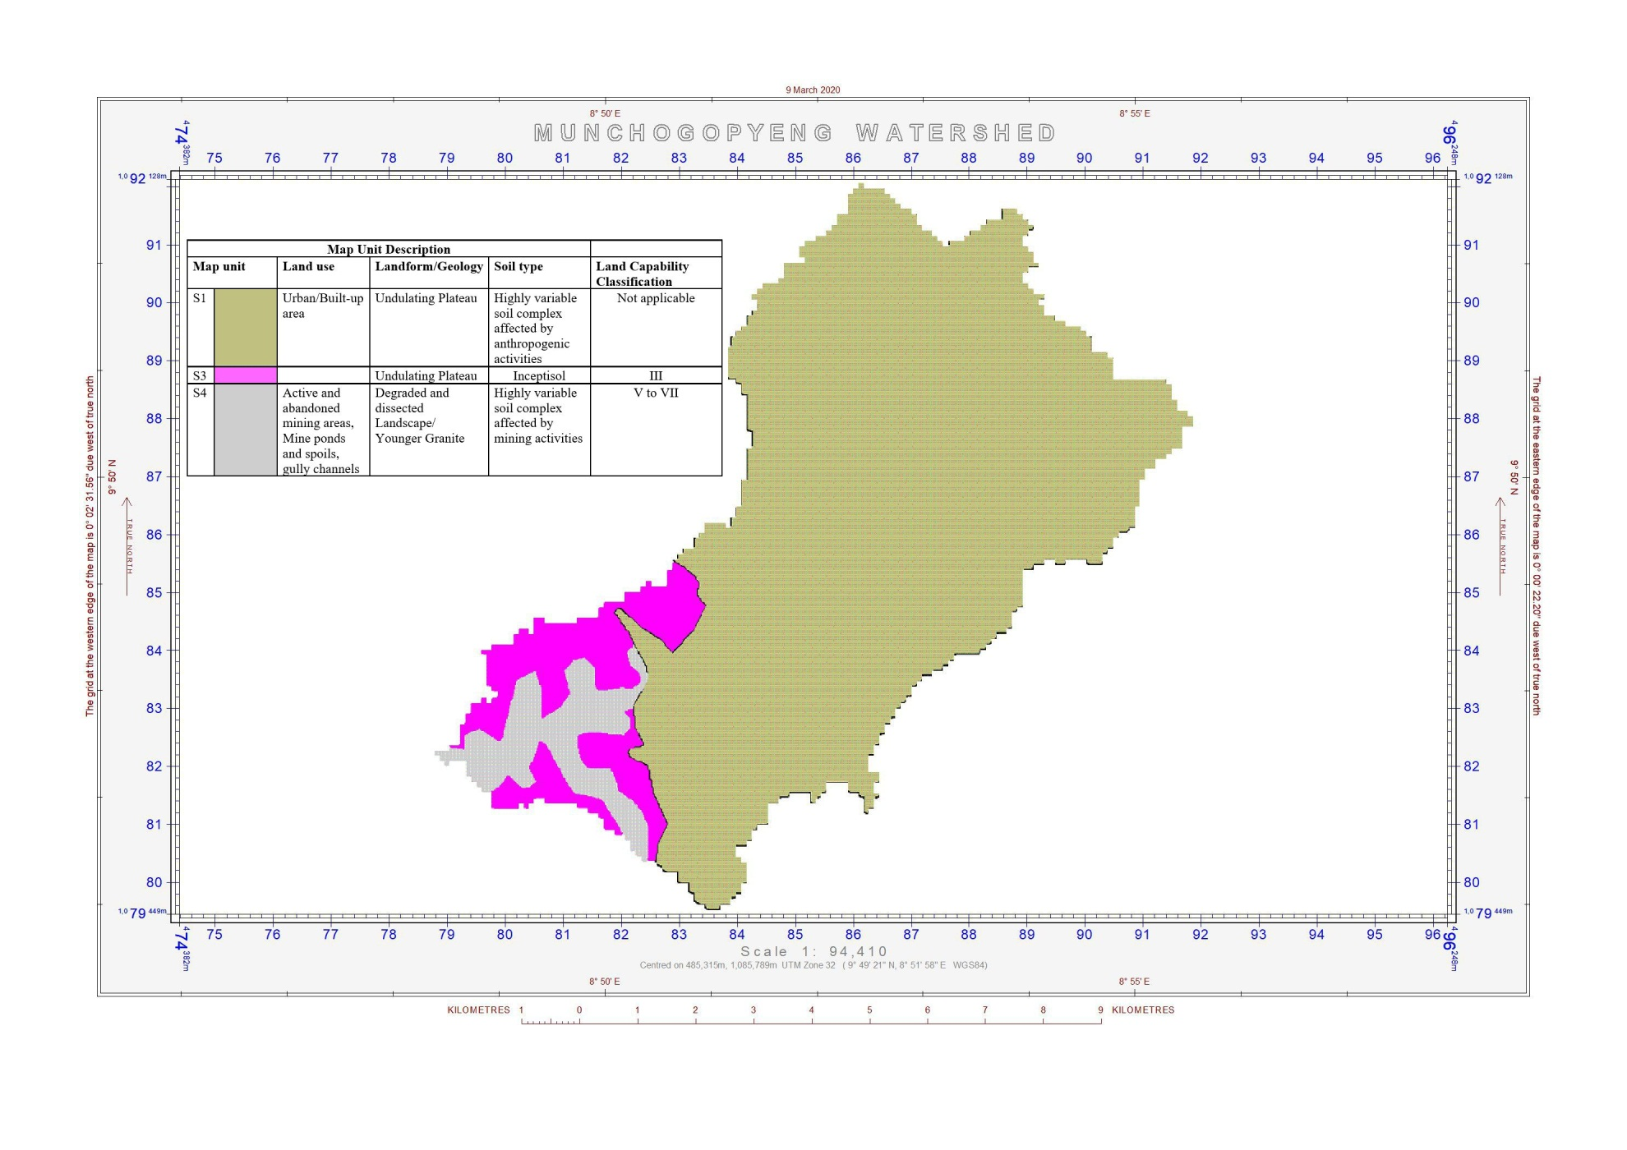
Figure 8. Soil map of Pyeng Catchment

Slide 23
Table 6. Soil Physical Properties
Profile | horizon | Depth (cm) | Gravel (%) | Sand (%) | Silt (%) | Clay (%) | Texture | K factor | Bulk Density (glcm³) | Porosity (%)
Muncho1 | A | 0-23 | 11.53 | 87.2 | 6.8 | 6 | LS | 0.75 | 1.98 | 25.28
 | C | 23-40 | 26.09 | 87.2 | 7.2 | 5.6 | GLS | 0.73 | 1.14 | 56.98
Muncho2 | A | 0-30 | 4 | 77 | 10.6 | 12.4 | SL | 1.24 | 0.76 | 71.32
 | AB | 30-50 | 25 | 68.6 | 18 | 13.4 | GSL | 1.06 | 0.97 | 63.40
 | B | 50-90 | 5.55 | 77.4 | 8.6 | 14 | SL | 1.52 | 1.08 | 59.25
 | C | 90-150 | 14.81 | 78.22 | 7.78 | 14 | SL | 1.48 | 1.07 | 59.62
Table 7.Soil Chemical Properties
Profile | horizon | Depth (cm) | pH | Nitrogen (%) | Organic matter (%) | Available Phosphorus (mg/kg) | Available Sulphur (mg/kg)
Muncho1 | A | 0-23 | 4.38 | 0.094 | 3.23 | 16 | 3
 | C | 23-40 | 4.58 | 0.065 | 2.23 | 7 | 1.7
Muncho2 | A | 0-30 | 4.18 | 0.058 | 1.99 | 9 | 2.3
 | AB | 30-50 | 4.68 | 0.032 | 1.12 | 6 | 1.8
 | B | 50-90 | 4.28 | 0.053 | 1.82 | 8 | 2
 | C | 90-150 | 4.7 | 0.022 | 0.74 | 5 | 0.52

Slide 24
Table 8. Cation Exchange Properties (cmol/kg)
Profile | horizon | Depth (cm) | Ca | Mg | Na | K | Exchangeable Acidity | Cation Exchange Capacity
Muncho1 | A | 0-23 | 0.92 | 0.36 | 0.0061 | 0.054 | 1.54 | 2.88
 | C | 23-40 | 1.55 | 0.51 | 0.018 | 0.13 | 1.61 | 3.69
Muncho2 | A | 0-30 | 0.95 | 0.38 | 0.007 | 0.054 | 1.56 | 2.95
 | AB | 30-50 | 1.03 | 0.47 | 0.01 | 0.1 | 1.59 | 3.2
 | B | 50-90 | 0.95 | 0.38 | 0.061 | 0.046 | 1.55 | 2.93
 | C | 90-150 | 1.53 | 0.5 | 0.018 | 0.12 | 1.61 | 3.78
Table 9. Soil color and consistence
 |  |  | Color |  | Consistence
Profile | horizon | depth | WET | DRY | AIR DRY | MOIST | STICKINESS | PLASTICITY
Muncho1 | A | 0-23 | 5YR 4/3 | 5YR 6/3 | SLIGHTLY HARD | VERY FRIABLE | NON STICKY | NON PLASTIC
 | C | 23-40 | 7.5YR 5/4 | 5YR 6/4 | VERY HARD | FRIABLE | SLIGHTLY STICKY | NON PLASTIC
Muncho2 | A | 0-30 | 7.5YR 4/4 | 5YR 6/4 | SLIGHTLY HARD | FRIABLE | SLIGHTLY STICKY | PLASTIC
 | AB | 30-50 | 7.5YR 6/4 | 10YR 8/5 | EXTREMELY HARD | FIRM | SLIGHTLY STICKY | SLIGHTLY PLASTIC
 | B | 50-90 | 7.5YR 4/4 | 7.5YR 5/4 | HARD | FRIABLE | STICKY | PLASTIC
 | C | 90-150 | 7.5YR 5/5 | 10YR 8/5 | VERY HARD | FRIABLE | NON STICKY | NON PLASTIC

Slide 25
Table 10. Physical properties of surface soil (0-15cm depth)
Sample No. | Gravel | Sand | Silt | Clay | Texture | K factor | Bulk Density | Porosity
 | (%) |  |  |  |  |  | (g/cm³) | (%)
49 | 0 | 77.4 | 17 | 5.6 | LS | 1.18 | 1.08 | 59.25
50 | 0 | 87.2 | 8.4 | 4.4 | S | 0.69 | 1.14 | 56.98
51 | 0 | 87.4 | 8.2 | 4.4 | S | 0.68 | 1.19 | 55.09
Table 11.Chemical properties of surface soil (0-15cm depth)
Sample | pH | N | OM | P | S | Ca | Mg | Na | K | EA | CEC
No. |  | % |  | mg/kg |  | cmol/kg
49 | 4.65 | 0.085 | 2.94 | 12 | 2.6 | 0.95 | 0.38 | 0.61 | 0.049 | 1.55 | 2.94
50 | 4.86 | 0.067 | 2.31 | 10 | 2.3 | 0.92 | 0.36 | 0.052 | 0.041 | 1.54 | 2.87
51 | 4.67 | 0.064 | 2.19 | 11 | 2 | 0.94 | 0.37 | 0.0056 | 0.051 | 1.54 | 2.91

Slide 26
Waste Management Practices
At the upper catchment around National Open University under the nearby bridge, a large deposit of solid waste was sighted.
Though as was generally observed, there seem to be a near absence of indiscriminate disposal of waste in this catchment.
It could be as a result of government’s efforts in waste evacuation in the catchment.
However, feacal waste was observed around hills and abandoned mine sites in some of the communities.

Slide 27
Air Quality
Table 12. Air quality of Pyeng catchment Plateau State Nigeria
Point | Longitude | Latitude | SO2 | NO2 | CO | CO2 | NO | O3 | H2S
1 | E8 55.197 | N9 49.488 | 1.00 | 0.06 | 0.00 | 0.00 | 0.00 | 0.00 | 0.00
2 | E8 52.509 | N9 49.616 | 0.40 | 0.10 | 0.00 | 0.00 | 0.00 | 0.00 | 0.00
3 | E8 51.983 | N9 49.468 | 0.80 | 0.05 | 0.00 | 0.00 | 0.00 | 0.00 | 0.00
4 | E8 51.874 | N9 50.237 | 0.40 | 0.07 | 0.00 | 0.00 | 0.00 | 0.00 | 0.00
5 | E8 51.649 | N9 50.143 | 0.40 | 0.08 | 0.00 | 0.00 | 0.00 | 0.00 | 0.00
6 | E8 51.746 | N9 49.572 | 0.50 | 0.09 | 0.00 | 0.00 | 0.00 | 0.00 | 0.00
7 | E8 52.030 | N9 50.028 | 0.70 | 0.07 | 0.00 | 0.00 | 0.00 | 0.00 | 0.00
8 | E8 52.117 | N9 50.273 | 0.10 | 0.07 | 0.00 | 0.00 | 0.00 | 0.00 | 0.00
9 | E8 53.186 | N9 54.188 | 0.70 | 0.05 | 0.00 | 0.00 | 0.00 | 0.00 | 0.00
Generally, all the parameters are below the NESREA Regulatory limits

Slide 28
Climate Issues
The present climate status and future trends in the project locations were determined through analysis of the elements of climate including rainfall, temperature (minimum, maximum and mean), relative humidity and wind speed. 35 years (1979-2013) climatic data was sourced from Global Weather (2019).
Generally, rainfall in the entire area is declining.
Temperature is on the increase.
The wind speed varies between 2 and 6 knots for most of the year with an average speed of about 4 knots. The maximum wind speed recorded within the period was 10 knots.

Slide 29
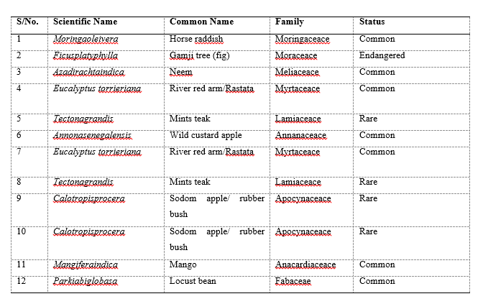
Biodiversity
Table 13. List of plants species in Pyeng Catchment

Slide 30
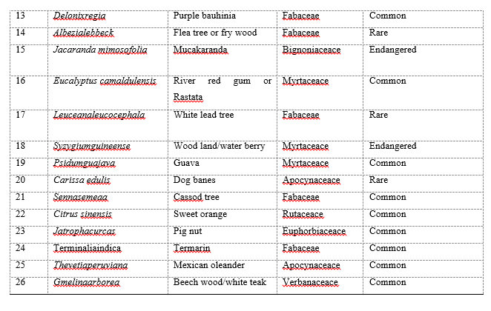

Slide 31
Table 14. Wildlife species in Pyeng catchment
S/N | Scientific Name | Common Name | Family | Status
1 | Otter strew | Potamogalevelox | Insectovore | Rare
2 | Epixerusepii | African palm squirel | Rodent | Rare
3 | Gazelladorcas | Dorcas gazelle | Artrodactyla | Endangered
4 | Python zebae | Rock python | Reptiles | Endangered
5 | Manisgigantean | Giant pangolin | Phoeidota | Endangered
6 | Manistricuspus | Tree pangolin | Phoeidota | Endangered
7 | Felisaurata | Golden cat | Carnivora | Endangered
8 | Felis caracal | Caracal | Carnivora | Endangered
9 | Felislibyca | Wild cat | Carnivora | Rare
10 | Cephalophussylvicultor | Yellow backed duiker | Artrodactyla | Rare
11 | Gorilla gorilla | Gorilla | Primate | Endangered
12 | Felisserval | Serval | Carnivora | Endangered

Slide 32
Table 15. List of some bird species in Pyeng catchment
S/N | COMMON NAME | SPECIES | FAMILY | NUMBER | CONSERVATION STATUS
1 | Hamerkop | Scopus umbretta | Scopidae | 4 | least concern
2 | Red eyed-dove | Streptopelia semitorquata | Columbidae | 8 | least concern
3 | Adamawa Turtle dove | Streptopelia hypopyrrha | Columbidae | 10 | least concern
4 | Crested Lark | Galerida cristata | Alaudidae | 5 | least concern
5 | Black Kite | Milvus migrans | Accipitridae | 2 | least concern
6 | Yellow-Crowned gonoleck | Laniarius barbarus | Malaconotidae | 1 | least concern
7 | Yellow-Fronted tinker bird | Pogoniulus chrysoconus | Lybiidae | 1 | least concern
8 | Northern Red Bishop | Euplectes franciscanus | Ploceidae | 5 | least concern
9 | Black billed-wood Dove | Turtur abyssinicus | Columbidae | 6 | least concern
10 | Black Crowned tchagra | Tchagra senegalus | Malaconotidae | 3 | least concern
11 | Red-Billed Firefinch | Lagonosticta senegala | Estrildidae | 3 | least concern
12 | Village Indigobirds | Vidua chalybeata | Viduidae | 2 | least concern
13 | Common Bulbul | Pycnonotus barbatus | Pycnonotidae | 6 | least concern
14 | Laughing Dove | Spilopelia senegalensis | Columbidae | 10 | least concern
15 | Black Kite | Milvus migrans | Accipitridae | 1 | least concern
16 | Pied Crow | Corvus albus | Corvidae | 7 | least concern

Slide 33
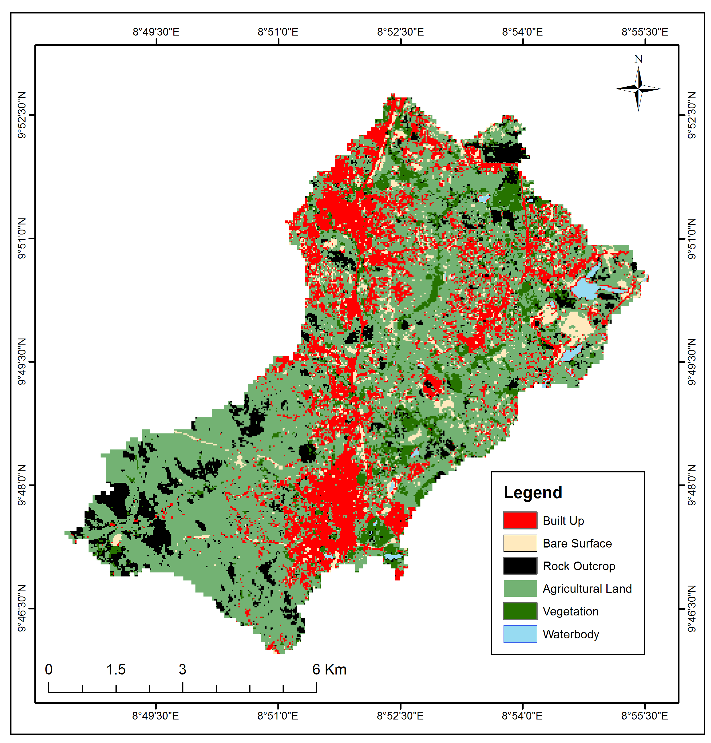
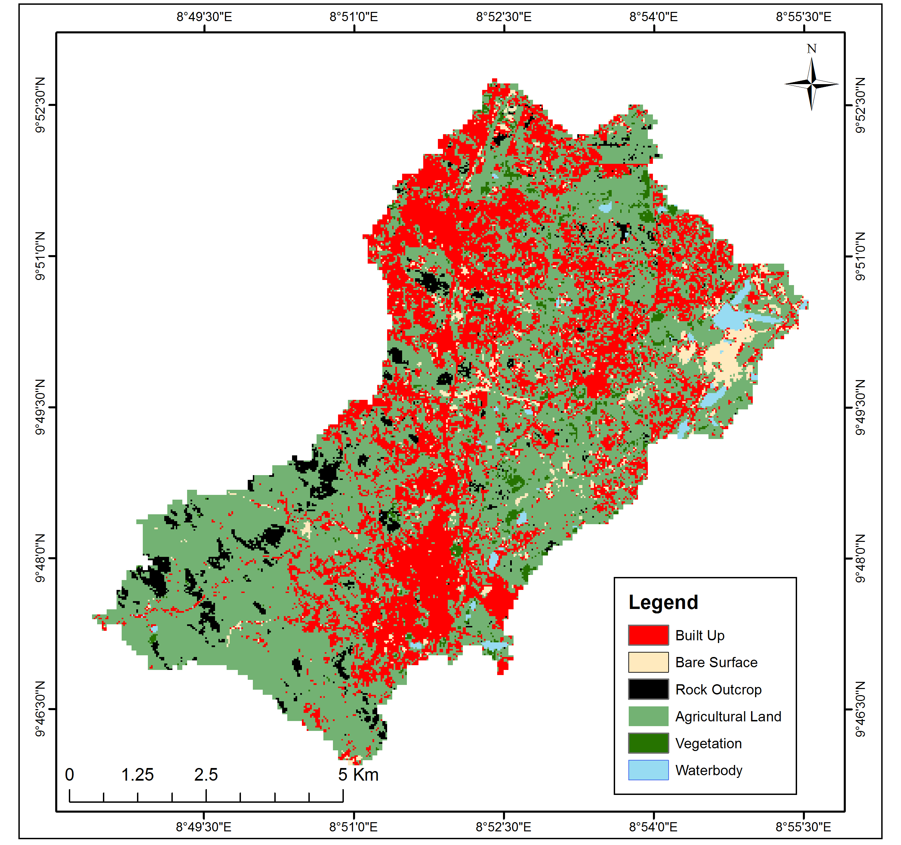
Land Use and Land Cover Dynamics
Figure 9. Land use and Land cover classes 2010
Figure 10. Land use and Land cover classes 2020

Slide 34
Table 16. Statistics of Land use classes in 2010
Table 17. Statistics of Land use classes in 2010
Class Name | Area (Ha)
Built Up | 1380.96
Bare Surface | 91.17
Rock Outcrop | 488.34
Agricultural Land | 549.09
Vegetation | 501.12
Water Body | 1.97
Class Name | Area (Ha)
Built Up | 1489.77
Bare Surface | 78.57
Rock Outcrop | 131.76
Scattered Cultivation | 1152.63
Vegetation | 158.34
Waterbody | 1.69

Slide 35
Demographic and Socio-Economic Characteristics
Table 18. Distribution based on family size
Table 19. Distribution based on age
Table 20. Distribution based on
the sources labour
Family size | Frequency Percent
≤3 | 21 | 22
4-9 | 69 | 72
10-15 | 6 | 6
≥16 | 0 | 0
Total | 96 | 100
Age | Frequency Percent
≤25 | 50 | 53
26-45 | 33 | 35
46-65 | 11 | 12
66-85 | 1 | 1
.≥86 | 0 | 0
Labour source | Frequency Percent
Family | 33 | 57.9
Hired | 22 | 38.6
Mechanized | 0 | 0.0
Communal | 2 | 3.5
Family and hired | 0 | 0.0
Family and communal | 0 | 0.0

Slide 36
Table 21. Distribution based on the estimates of
total and Per capita income
Table 22. Estimates of the poverty status of respondents
Variable | Pyeng
Number of responses | 53
Total income | 2813900
Per capita income | 53092.453
The Foster, Greer and Thorbeck (1984) weighted poverty index was used to determine the poverty status of the catchment areas inhabitants

Slide 37
Table 23. Distribution based of the livelihood activities of respondents

Slide 38
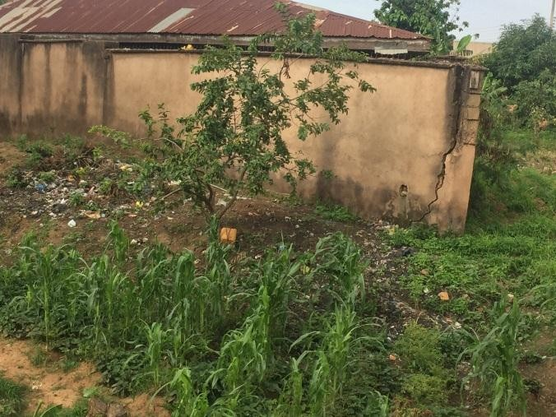
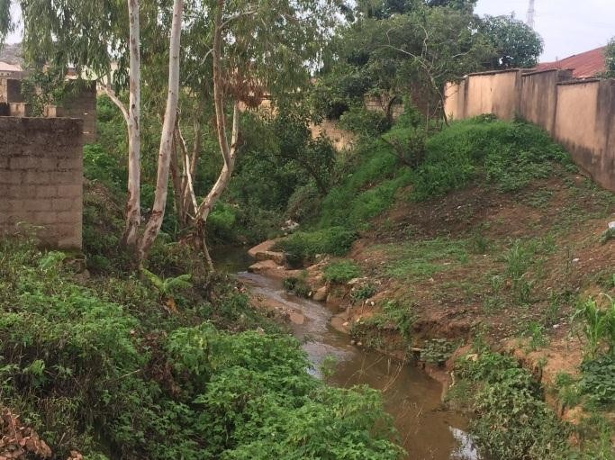
Key Findings
The gullying observed beside the National Open University of Nigeria is as a result of stream bank erosion and back-cutting caused by the flowing water of a tributary of a major river. Some buildings were observed to be under threat from the erosion menace (Plate 2 and 3).
Plate 2. A building beside the open university at the verge of collapsing as a result of erosion
Plate 3. Buildings along a stream being threatened by erosion

Slide 39
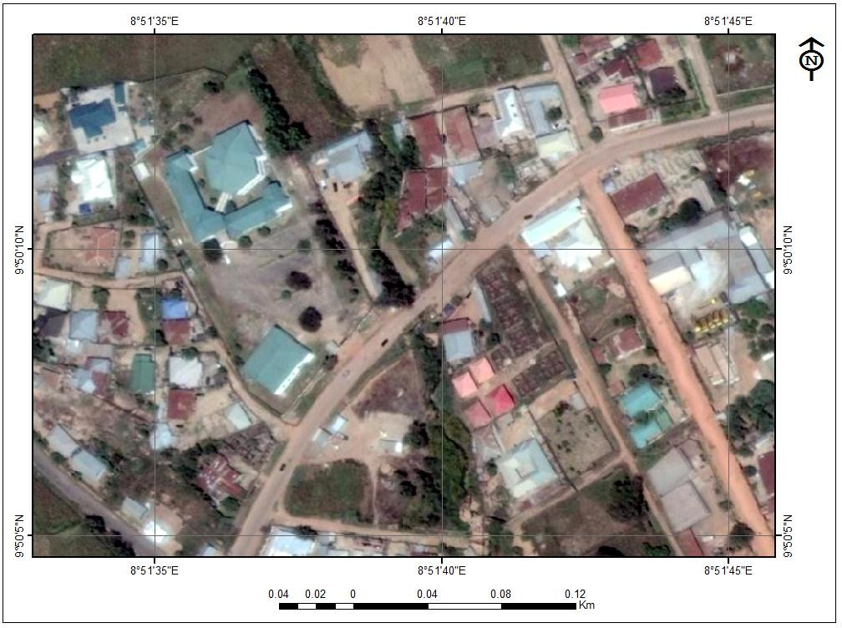
Figure 11. Satellite imagery of the
area around the National Open
University of Nigeria
(erosion site is in red circle)

Slide 40
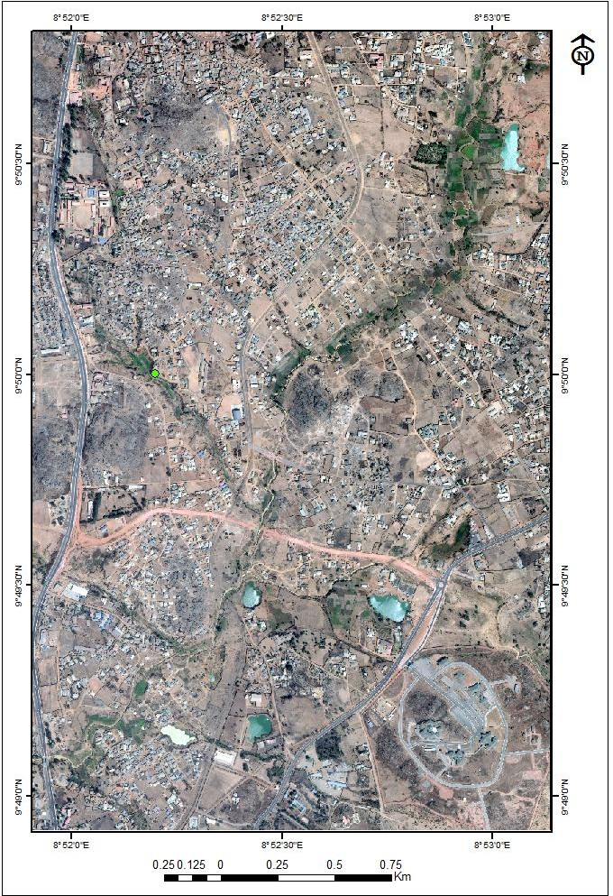
Figure 12. Satellite imagery of the area behind the former Uma bread bakery (erosion site is in red circle)

Slide 41
Pyeng community satisfy their water needs for domestic purposes from pipe borne water and individual motorised boreholes and hand dug wells.
Because of the locations of the streams, they have been used by the communities as waste dump, open defecation sites and their waters are being used for irrigation activities. Coliform counts in the waters are higher than what the WHO and the NSDWQ recommended probably due to rampant open defecation in some parts of the catchment.
The cloudy nature of the water in the lower catchment has led to high E.coli concentration isolated from the waters compared to the upper and middle catchments. Also, cadmium and nickel are higher in the lower catchment than the middle; these probably may be the result of huge plastic materials and polyethene bags that have been dumped in the stream channel.

Slide 42
The gaseous elements in the catchment are within the limits for urban air quality standard as given by the National Environmental Standards and Regulatory Agency (NESREA).
The climate analysis of the catchment shows temperature is on the increase leading to higher evapotranspiration, vegetation loss with capacity to enhance soil erosion.
Natural vegetation has been tempered with by the activities of human in the area, due to collection of fuel wood, income generation and building which has fragmented the forest ecosystem and cause run off and erosion.
The study found that most of the households in the catchment were poor based on the poverty line. The result indicated that 67% of the households fell below the poverty line. Majority of them (88%) were within the active age bracket of less than 45 years.

Slide 43
CMP for the upper catchment
S/N | KEY PROJECT ACTIVITIES | TARGET | TIMELINE | EXPECTED OUTPUT | RESPONSIBILITY | MONITORING INDICATOR
PRIMARY PRIORITY
1 | Planting of trees, shrubs and grasses on vulnerable lands | Entire community |  | Re-vegetation of the catchment and eventual slowing down of erosion process | Horticulture/forestry experts, community | Number of trees crops, shrubs and area of grasses planted.
2 | Provision of waste bins | Whole community |  | Waste is properly disposed | Ministry of Environment, Community | Number of waste bins provided
3 | Enlightenment campaign on best practices on solid waste management, soil and water conservation | The whole community |  | Improved crop yields and water quality | Contractor, Ministry of environment, community. | Enlightenment campaign on best practices for soil fertility management and soil conservation
SECONDARY PRIORITY
1 | Homestead tree planting to curb erosion and provide income to community | Whole community |  | Re-vegetation of the catchment and eventual slowing down of erosion process and provion of income | Horticulture/forestry experts, community | Number of trees planted
2 | Provision of public toilet facilities | CIG Waste management |  | Reduction in open defecation | Consultant, Ministry of environment, community. | Number of toilet facilities provided
3 | Regulation and organization of quarries | Stone crushers and the whole community |  | Enlightenment on advantages of proper mining activity | Ministries of Solid minerals, Health, Water Resource, , Community. | Regulation and organization of artisanal mining of tins and columbites

Slide 44
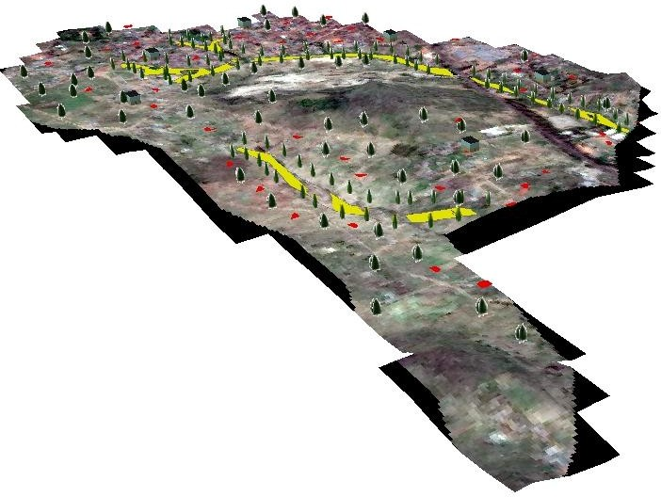
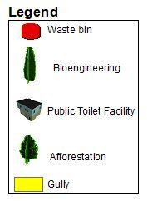
Figure 13. 3D view of the upper catchment showing the locations of some of the proposed interventions

Slide 45
CMP for the
Middle Catchment

Slide 46
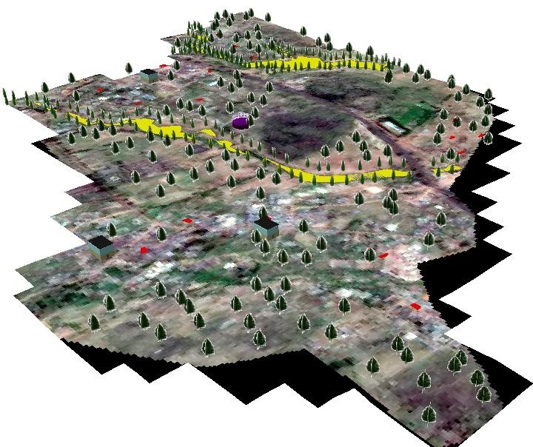
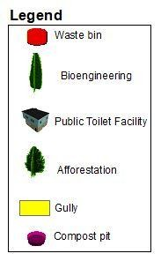
Figure 14. 3D view of the
middle catchment showing
the locations of some of the proposed interventions

Slide 47
CMP for the
Lower Catchment

Slide 48
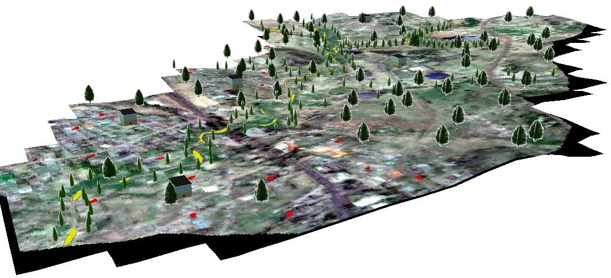
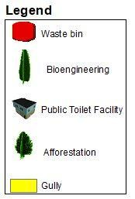
Figure 15. 3D view of the lower catchment showing the locations of some of the proposed interventions

Slide 49
Conclusion
The suggested interventions combines the process of engagement and consultation into several mitigation actions to achieve desirable outcomes for the development of the catchment.
It is expected that this sub-catchment ICMP will undergo periodic review to maintain relevance to national, regional and local policy.
It is also recognized that monitoring of possible changes within the catchment will be required as the development advances.

Slide 50
References
Abu, A. (2011). Project Information Document (PID) Concept Stage: Nigeria Erosion and Watershed Management Project Report No. AB6300. A Project document submitted to the Federal Ministry of Agriculture, Abuja, Nigeria.
Giddens, A. (2008). The Politics of Climate Change: National Responses to the Challenge of Global Warming. London: Policy Network.
Igbokwe, J. I., Akinyede, J. O., Dang, B., Alaga, T., Ono, M. N., Nnodu, V. C. and Anike, L. O. (2008). Mapping and monitoring of the impact of gully erosion in Southeast Nigeria with satellite remote sensing and geographic information system, the international archives of the photogrammetry, remote sensing and spatial information sciences, vol. xxxvii, part B 8, Beijing.
Japan International Cooperation Agency (JICA) (2014). The Project For Review And Update of Nigeria National Water Resources Master Plan. Federal Ministry Of Water Resources. Volume 2.
Jimoh, H. I. (2008). Approaches to studying soil erosion problems in a tropical environment: An overview. Pakistan Journal of Social Sciences, 5(2): 142-146.
NSDWQ, (2007). Nigerian Standard for Drinking Water Quality. Nigerian Industrial Standard (NIS) 554, Standards Organization of Nigeria p30.

Slide 51
THANK YOU FOR
YOUR TIME

