Slide 1
SOIL
And catchment management plan

Slide 2
The Catchment and Soil Development
Topography of the catchment modifies soil development in three ways:
influences the quantity of precipitation absorbed and retained in the soil, thus affecting moisture retention

Slide 3
The Catchment and Soil Development
Topography of the catchment modifies soil development in three ways:
influences the rate of removal of the soil by erosion
directs movement of materials in suspension or solution from one area to another.

Slide 4
Processes of Soil Erosion by Water
Detachment of soil particles from the soil mass.
Transportation of the detached particles down the slope by floating, rolling or dragging.
Deposition of the transported soil particles at some place lower in elevation or in depressions on the soil surface.

Slide 5
Effects of Man’s Activities on the Soil Environment
Agricultural
Slope wise cultivation
Bush burning
Over grazing
Over cropping
Crop residue harvesting

Slide 6
Effects of Man’s Activities on the Soil Environment
Urbanization
Deforestation
Mining activities

Slide 7
SOIL SURVEY
Soil survey, or more properly, soil resource inventory, is the process of determining the pattern of the soil cover, characterizing it, and presenting it in understandable and interpretable form to various consumers.

Slide 8
SOIL SURVEY
A soil survey results in the preparation of a soil map and an accompanying soil report.
It is a scientific report that presents the inventory of the soils found in an area, their geographic distribution and their chemical and physical characteristics in relation to terrain, land use, vegetation characteristics and climate.

Slide 9
Benefits of Soil Surveys
Land evaluation and land use planning at various levels,
Land capability Assessments
Land Suitability Assessments

Slide 10
Benefits of Soil Surveys
Site specific introduction of new crops,
Development of improved management practices
Establishment of soil data bank for environmental monitoring and management

Slide 11
Benefits of Soil Surveys
Design of soil and water conservation for land reclamation projects,
Assessment of soil production potentials,
Lay-out of irrigation and drainage schemes

Slide 12
Benefits of Soil Surveys
Determination of levels of inputs for the intensification of agriculture,
Feasibility study for agriculture development programmes
Construction of infrastructures,

Slide 13
Soil Conservation
The conservation of soil implies utilization with out depletion or deterioration so as to make possible a continuous high level of crop production while improving or sustaining environmental quality.

Slide 14
Soil Conservation
A combination of all management and land use methods that safeguard the soil against depletion or deterioration caused by nature and or humans.

Slide 15
Benefits of Soil Conservation
Prevention of soil erosion on agricultural and urban land areas.
Conservation of soil nutrients on farmlands
In low rainfall areas, conservation increases retention of soil moisture while dams are also built for irrigation purposes.

Slide 16
Benefits of Soil Conservation
In high rainfall areas, conservation helps to prevent water logging through efficient design of drainage systems.
In lowlands, coastal areas and palaces close to rivers; conservation helps to prevent the flooding of agricultural and urban lands.
Conservation also enhances or conserves soil physical properties such as texture, structure, bulk-density, and infiltration rate.

Slide 17
Case Study: One

Slide 18
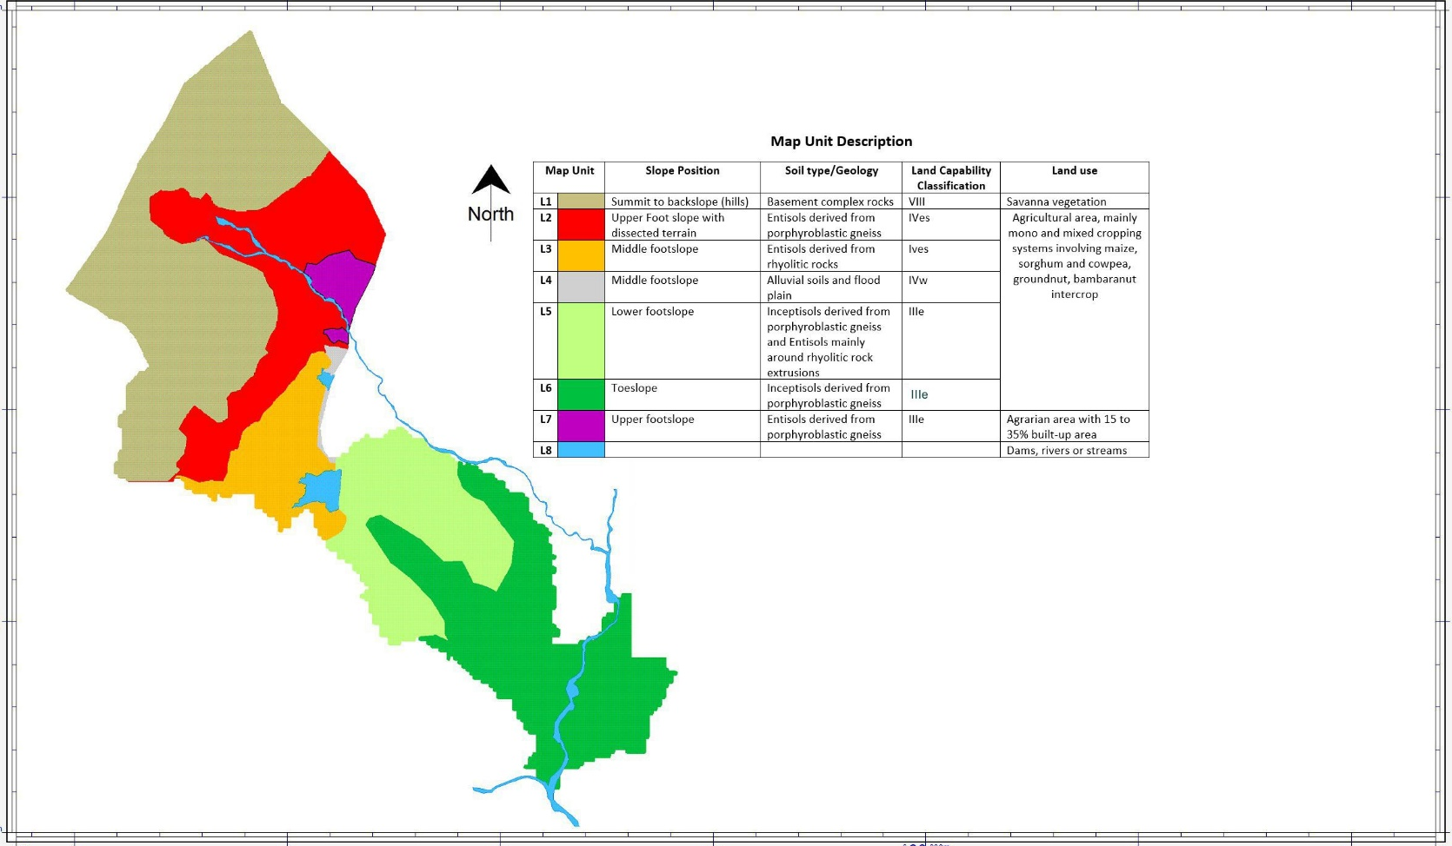

Slide 19
Case Study: Two

Slide 20
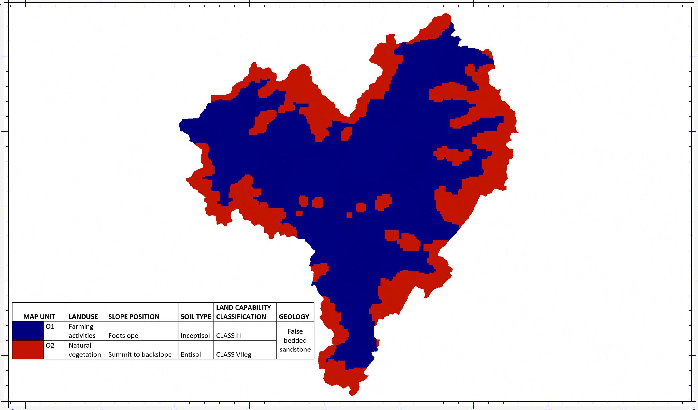

Slide 21
THANK YOU
FOR LISTENING

