Slide 1
THE ROLE OF BIODIVERSITY on SUSTAINABle catchment MANAGEMENT By Thlama Daniel Mshelbwala

Slide 2
The term biodiversity (from “biological diversity”) refers to the variety of life on earth at all its levels, from genes to ecosystems, and can encompass the evolutionary, ecological, and cultural processes that sustain life. Biodiversity plays an important role in the way ecosystems function and in the many services they provide. Services include nutrient and water cycling, soil formation and retention, resistance against invasive species, pollination of plants, regulation of climate, as well as pest and pollution control by ecosystems. The biggest impact of biodiversity is on the environment. Healthy ecosystems help to maintain the earth's natural processes. Soil turnover, water purification, pest control, and other processes wouldn't be possible without the species that support them. Interruptions to these processes can be devastating.

Slide 3
Biodiversity supports human and societal needs, including food and nutrition security, energy, development of medicines and pharmaceuticals and freshwater, which together underpin good health. It also supports economic opportunities, and leisure activities that contribute to overall wellbeing. Scientists have long hypothesized that biodiversity is of critical importance to the stability of natural ecosystems and their abilities to provide positive benefits such as oxygen production, soil genesis, and water detoxification to plant and animal communities, as well as to human society.

Slide 4
1. To preserve the diversity of species Support local and regional projects aimed at tackling biodiversity loss. Buying fewer products and making sure the products you do buy minimize the impact on biodiversity. Investing in ways that promote biodiversity, reducing waste of consumer goods: food, clothes, electrical appliances, etc, as a general rule, increasing biodiversity can be achieved by diversifying the range of habitats or vegetation structures available at a site. This can be achieved by, for example, varying mowing regimes, planting or seeding with native tree and shrub species, or occasional soil disturbance.
THE ROLE OF BIODIVERSITY IN CATCHMENT AREA HAS THREE MAIN OBJECTIVES:

Slide 5
Several factors contribute to species diversity, including habitat diversity, competition among species, and genetic diversity. Genetic diversity within a species not only is necessary to maintain diversity among species, but also contributes to the diversity of food, fiber, and medicines available from nature. One of the easiest and most effective ways to help wildlife is to preserve the environment in which the animals live. Volunteer with organizations in your area to restore native forests, grasslands, and coastal ecosystems by planting native species, manually removing invasive plant species, and taking out old fences. Species diversity has two primary components: species richness (the number of species in a local community) and species composition (the identity of the species present in a community). Six ways to preserve biodiversity i. Support local farms ii. Save the bees iii. Plant local flowers, fruits and vegetables iv. Respect local habitats v. Know the source

Slide 6
Sustainable use of species and ecosystems has been achieved in the past by tribal cultures in which people have become intimately familiar with the natural environments that they occupy. Sustainable use is still achieved most readily by local people who have time and opportunity to develop a detailed knowledge of the land that they occupy. Today, however, most rural inhabitants rarely have the culturally transmitted knowledge needed for them to achieve an economy which both satisfies their basic needs and enables them to perpetuate biotic diversity and achieve sustainability. New advances in computer and communication technology now open the possibility for local communities to combine familiarity with their local environments and a global awareness of ecological reality. Sustainable use is when biodiversity and ecosystem functioning are maintained while contributing to human wellbeing. Sustainable utilization of natural resources is the proper management of natural resources for the benefit of the entire human community. The main aim of sustainable development is to provide resources for present generations without compromising the needs of future generations.
2. Sustainable utilization of species and ecosystem

Slide 7
Plate 1: Sustainable Management in the Ecosystem.

Slide 8
African priorities in reaching green growth include: building resilience to climate shocks; climate-proofing infra- structure; and, efficient management of natural resources, especially water 74. Green growth would also strengthen agricultural productivity and food security in the region (afdb, 2013). Socially, sustainable practices can help strengthen community bonds, improve quality of life and provide hope for a better future. Environmentally, sustainable practices can help protect natural resources, mitigate and adapt to climate change and promote biodiversity. Ecosystems themselves couldn't be sustained without the consistency of underlying natural processes, such as photosynthesis, nutrient cycling, the creation of soils, and the water cycle. These processes allow the earth to sustain basic life forms, let alone whole ecosystems and people.

Slide 9
Ecological processes such as primary production, respiration, energy, carbon and nutrient flow through food webs, reproduction, and decomposition are represented as rates of change, which requires repeated measurement over time.
3. To maintain life-supporting systems and essential ecological processes

Slide 10
Plate 2. Ecosystem

Slide 11
1. Changes in land and sea use or habitat destruction and fragmentation Habitat destruction is the process by which natural habitat is damaged or destroyed to such an extent that it no longer is capable of supporting the species and ecological communities that naturally occur there. It often results in the extinction of species and, as a result, the loss of biodiversity.
THE FIVE GREATEST DRIVERS OF BIODIVERSITY LOSS WITH THE LARGEST GLOBAL IMPACT ARE:

Slide 12
Plate 3: Habitat destruction

Slide 13
Habitats can also be degraded when natural process they depend on, such as fire or flooding, are altered by human activity. Habitat degradation is another consequence of human development. Humans indirectly cause habitat degradation through pollution, climate change, and the introduction of invasive species, all of which reduce the quality of the environment, making it difficult for native plants and animals to thrive. Habitat degradation is fueled by a fast-growing human population. As the population increases, humans use more land for agriculture and for the development of cities and towns spread out over ever-widening areas. The effects of habitat degradation not only affect native species and communities but human populations as well. Degraded lands are frequently lost to erosion, desertification, and nutrient depletion.

Slide 14
Plate 4: Habitat destruction on mining site

Slide 15
Habitat fragmentation describes the emergence of discontinuities (fragmentation) in an organism's preferred environment (habitat), causing population fragmentation and ecosystem decay. Causes of habitat fragmentation include geological processes that slowly alter the layout of the physical environment (suspected of being one of the major causes of speciation, and human activity such as land conversion, which can alter the environment much faster and causes the extinction of many species. More specifically, habitat fragmentation is a process by which large and contiguous habitats get divided into smaller, isolated patches of habitats.
Habitat Fragmentation

Slide 16
Plate 5 Habitat fragmentation

Slide 17
Human development also leads to habitat fragmentation, as wild areas are carved up and split into smaller pieces. Fragmentation reduces animal ranges and restricts movement, placing animals in these areas at higher risk of extinction. Breaking up habitat can also separate animal populations, reducing genetic diversity. Habitats can also be degraded when natural process they depend on, such as fire or flooding, are altered by human activity. Habitat fragmentation occurs when large blocks of habitat are cut into smaller pieces by development such as roads or housing. Urbanization and urban sprawl are major drivers of habitat loss worldwide. In today's era of rapid urban expansion, cities and outlying suburbs are demanding an unprecedented amount of land and resources, and are encroaching on biodiversity hotspots and protected areas. Habitat fragmentation describes the process by which continuous preferred habitat is broken into distinct smaller areas. Habitat destruction describes the process by which preferred habitat is destroyed; it has been changed to the point where it can no longer be used by the organisms that once used it.

Slide 18
Overexploitation, also called overharvesting, refers to harvesting a renewable resource to the point of diminishing returns. Continued overexploitation can lead to the destruction of the resource, as it will be unable to replenish. Examples include the over-harvesting of fish and timber that degrades fisheries and forests, and non-sustainable agriculture and land-use that make future land-use less effective.
2. Direct exploitation of organisms or over-exploitation of resources

Slide 19
Plate 6: Habitat destruction

Slide 20
What causes the depletion of our natural resources? - Overpopulation - Overconsumption and waste - Deforestation and the destruction of ecosystems leading to loss of biodiversity - Mining of minerals and oil. - Technological and industrial development. - Erosion. - Pollution and contamination of resources. Things we can do to start protecting the earth's resources. - Make electricity use more efficient - use more renewable energy. - Promote sustainable fishing rules. - Avoid single-use plastics. - Drive less. - Recycle more and improve recycling systems.

Slide 21
Climate change is caused by the release of billions of tons of carbon dioxide (CO2) and other heat trapping gases known as green house gases into the atmosphere. This results in depletion of ozone layer leading to increase in the earth’s surface temperature due to direct heating of earth’s surface by the sun. This paper discusses the impact of climate change on food security. Climate change impacts on food security in a number of ways. Climate change is impacting on oceans, seas, lakes and rivers and on the animals and plants that are found and/or cultured in them. In Nigeria, thousands of people and their families whose livelihood depend on fishing and aquaculture are affected by climate change as fish become less abundant because many migrate to other areas due to extreme weather events, droughts and the warming of waters.
3. Climate Change

Slide 22
Furthermore, climate change results in low agricultural productivity increase in agricultural pests and diseases, hunger and starvation and in extreme cases death. Various adaptation strategies for coping with the effects of climate change on food security are discussed among which are: use of more efficient crop varieties, more efficient irrigation and watershed management, efficient use of climate data and forecasts, through early warning systems, changing planting dates, and introducing irrigation into current rain fed systems. Long-term changes in temperature and weather patterns are referred to as climate change. These movements might be due to natural causes, such as changes in the solar cycle. However, human activities have been the primary cause of climate change.

Slide 23
Plate 7: Effect of climate change

Slide 24
Climate change has occurred in the past, but the current changes are faster than any known occurrence in earth’s history. Carbon dioxide (CO2) and methane, are the primary reason. Additional sources include agriculture, steel manufacturing, cement production, and forest loss. These factors, taken together, accelerate global warming. Natural causes of climate change Long before humans were on the scene, the world experienced periods of warming and cooling. This occurred due to: - The sun’s intensity - Volcanic eruptions - Variations in naturally existing greenhouse gas concentrations
Why is Climate Change taking place?

Slide 25
Human induced causes of climate change Greenhouse gas emissions produced by human activities are the primary cause of today’s rapidly changing climate. Since olden times, carbon dioxide in the atmosphere has increased by 46 percent. This makes it the planet’s primary contributor to climate change. Examples include: - Combustion of fossil fuels such as coal, oil, and gas for power, heat, and transportation. - Deforestation - logging, clear-cutting, fires, and other types of forest degradation - Fertilizer usage (a significant source of nitrous oxide emissions) - Animal raising (cattle, buffalo, sheep, and goats are important methane emitters) - Industrial operations that create fluorinated gases Our planet’s woods and seas absorb greenhouse gases from the atmosphere via photosynthesis and other processes. Then also, they are unable to keep up with our increasing emissions. As a result of the accumulation of greenhouse gases, the earth is warming at an alarmingly rapid rate. During the twentieth century, the earth’s average temperature climbed by around 1 degree fahrenheit. If you don’t think that’s a lot, consider this: when the last ice age ended, average temperatures were just 5 to 9 degrees lower than they are now.

Slide 26
Plate 8 Human factor on climate change

Slide 27
i. Nature and wildlife climate change is projected to lead to the extinction of a large number of species. Many terrestrial and freshwater species have migrated pole ward and to higher altitudes as a result of recent warming. Heat waves and drought have lowered and bleached coral reefs. Ocean acidification makes it difficult for species like mussels, barnacles, and corals to form shells and skeletons. Harmful algal blooms reduce oxygen levels, disrupt food webs, and result in a significant loss of marine life.
HOW IS IT AFFECTING THE ENVIRONMENT?

Slide 28
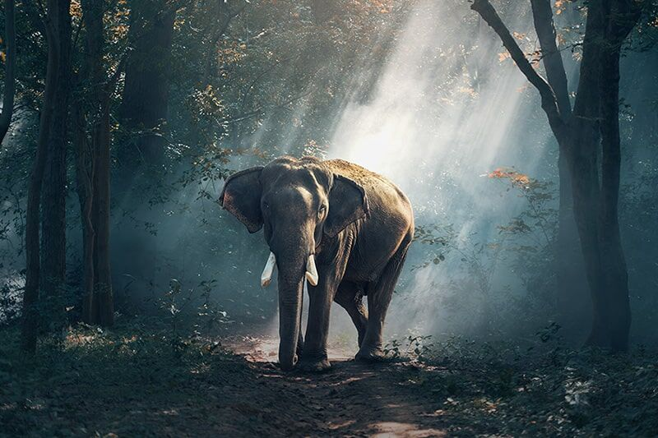
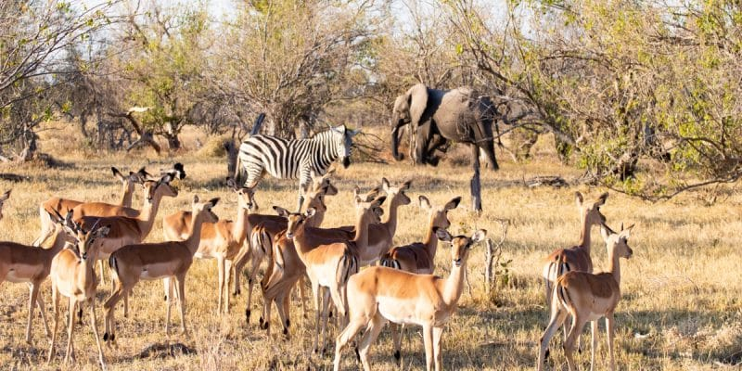
Plate 9 Change in weather due to change in climate

Slide 29
Since the late 1800s, the planet’s average surface temperature has climbed by around 1.18 degrees celsius. This is mostly because of rising carbon dioxide emissions into the atmosphere and other human activities. The last 40 years have seen the most warming, with the last seven years being the hottest. 2016 and 2020 are tied for the hottest year ever recorded.
ii. Global temperature rise

Slide 30
Plate 10 Temperature changes

Slide 31
iii. Warming Ocean although the waters have warmed more slowly than land, plants and animals in the ocean have moved to the frigid poles at a quicker rate than land-based species. The water has absorbed much of the extra heat, with the warming of more than 0.33 degrees celsius in the top 100 meters since 1969. 90% of the surplus energy on earth is stored in the ocean. iv. Shrinking Ice Sheets the bulk of the greenland and antarctic ice sheets has shrunk. Greenland lost an average of 279 billion tons of ice every year between 1993 and 2019. Antarctica lost roughly 148 billion tons per year.

Slide 32
Air pollution was responsible for 1·1 million deaths across Africa in 2019. Household air pollution accounted for 697 000 deaths and ambient air pollution for 394 000. These particles penetrate deeper into the lungs and lead to several diseases caused by air pollution in India like strokes, asthma, bronchitis, heart attacks, lung disease, cancer and premature death from heart ailments.
4. Pollution and Diseases

Slide 33
Plate 11 Pollution

Slide 34
Outdoor PM_{2.5} is the most consistent predictor of deaths from cardiovascular, respiratory, and other diseases in studies of long-term exposure to air pollution. In 2019, air pollution contributed to an estimated 1.1 million deaths in Africa, with 63% linked to exposure to household air pollution (HAP). Diseases caused by air pollution. - Cardiovascular diseases. - Cancer. - Neurological disorders. - Gastrointestinal disorders. - Kidney diseases. - Liver diseases. - Skin diseases. - Asthma.

Slide 35
Both short and long-term exposure to air pollution can lead to a wide range of diseases, including stroke, chronic obstructive pulmonary disease, trachea, bronchus and lung cancers, aggravated asthma and lower respiratory infections. Road vehicles and outdoor forms of heating are examples of low-level emissions that cause air pollution in Africa. The industrialization that could prevent outdoor pollution is in progress but still requires attention to prevent emissions. Acid rain is becoming more prevalent due to pollution. Pollutants in the environment or climate-related events can have a massive impact on our health. Air and noise pollution, and heavy metals like mercury are directly related to health issues like asthma, hearing loss, dehydration and heart diseases.

Slide 36
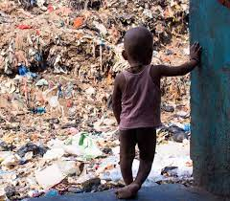
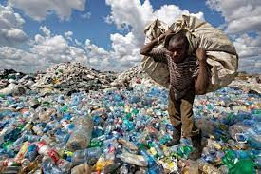
Plate 12: Waste and Plastic Pollution

Slide 37
Common invasive species, especially plants in Nigeria include tithonia diversifolia, chromolina odorata, leucaena leucocephala, gliricidia sepium. A recent invasive insect is the fall armyworm (spodoptera frugiperda). Fall armyworm (FAW), was recognized as a serious economic pest two centuries ago.
5. Introduction of Invasive Species

Slide 38
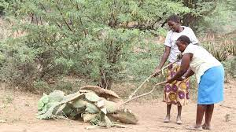
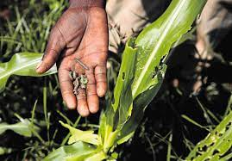
Plate 13 Showing the Invasive Species

Slide 39
A few well-known examples include the unintentional introduction of the west nile virus, chestnut blight, the south american fire ant, zebra mussels, burmese pythons, and sea lamprey. These are in addition to the intentional introductions of salt cedar (tamarisk), kudzu vine, house sparrows, starlings, and nutria. As explored above, we can conclude that humans are an invasive species. As humans spread out to parts previously uninhabited by them, the increase in population caused losses in biodiversity even hundreds and thousands of years ago. Human activities are the biggest cause of the spread of invasive species. Sometimes humans move animals and plants around the world deliberately, for example to change an environment, as a form of pest control, to hunt, as horticultural specimens or to keep as pets. Invasive species are primarily spread by human activities, often unintentionally. People, and the goods we use, travel around the world very quickly, and they often carry uninvited species with them. Ships can carry aquatic organisms in their ballast water, while smaller boats may carry them on their propellers.

Slide 40
Catchment is an area of land, usually bounded by mountains, over which water flows and is collected by the natural landscape. In a catchment, all rain and run-off water eventually flows into a creek, river, lake, lagoon or the ocean. In some places small catchment areas join up to form a larger catchment. Why are catchments important? Catchments provide people, stock and flora and fauna with drinking water. They provide people with water for domestic and industrial use, including irrigation, and they cater for recreation and tourism. They may also include important cultural sites. Catchment areas generally fall under two categories, those that occur organically, i.e., "De facto" catchment area, and a place people are naturally drawn to, such as a large shopping centre.

Slide 41
Catchment is an area of land, usually bounded by mountains, over which water flows and is collected by the natural landscape. In a catchment, all rain and run-off water eventually flows into a creek, river, lake, lagoon or the ocean. In some places small catchment areas join up to form a larger catchment. Healthy water catchment provides high-quality drinking water and supports livelihoods such as agriculture, recreational angling and water sports. It also supports local ecosystems so plants, animals, fish and insects that depend on having healthy water can thrive and flourish.

Slide 42
Plate 14 Showing Water Catchment

Slide 43
School catchment area can be useful for schools and local authorities to place children in local schools. There are several advantages for the children within these catchment areas too: friends: by using catchment areas it ensures that most children are educated in the same area where they live. Catchment management is balancing the use and conservation of natural resources on a whole of catchment basis. Catchment management is achieved through the combined efforts of the community, government and non-government organizations working together towards common and sustainable targets to achieve this balance. A healthy water catchment provides high-quality drinking water and supports livelihoods such as agriculture, recreational angling and water sports. It also supports local ecosystems so plants, animals, fish and insects that depend on having healthy water can thrive and flourish.

Slide 44
Plate 15: Catchment Management Land

Slide 45
The aim of catchment management is to protect and enhance the water environment through managing the surrounding land. Catchment areas generally fall under two categories, those that occur organically, i.e., "De facto" catchment area, and a place people are naturally drawn to, such as a large shopping centre. A catchment is a basin shaped area of land, bounded by natural features such as hills or mountains from which surface and sub surface water flows into streams, rivers and wetlands. Water flows into, and collects in, the lowest areas in the landscape.

Slide 46
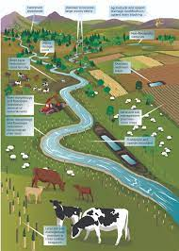
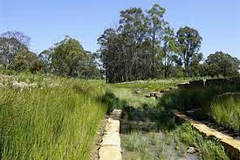
Plate 16: Catchment Management sites

Slide 47
You can map a catchment area by looking at a topographic map. Topographic maps are a representation of different contour lines or changes in land height. These are available through some state government departments, such as the department of environment and resource management. \ Catchment area may be defined as the area from which the surface runoff is derived. It is also known as watershed area, drainage area, drainage basin or simply basin or catchment. The unit for the catchment area is km². If the catchment area is less than 25 km², it is mentioned in terms of hectares. In geography, a catchment area is an area of land that collects water after rainfall, typically bounded by hills. Water flows down into these areas and collects into rivers and streams. These areas are useful for analyzing a geographic area, as it aims to understand waterfall and flow in the area. Why are catchments important? Catchments provide people, stock and flora and fauna with drinking water. They provide people with water for domestic and industrial use, including irrigation, and they cater for recreation and tourism. They may also include important cultural sites.

Slide 48
Conclusion
Over the years the vegetation seems to be intact, because of less pressure on forest resources in the catchment. Nowadays, due to mismanagement, ignorance, lack of policy implementation and over exploitation, most of the communities or inhabitant cannot afford kerosene, gas for cooking and other source of energy, putting pressure on forest, collecting fuel wood for cooking, wood for building, charcoal production for income generation, wood and tree leaves for herbs for traditional medicine as traditional knowledge and food.

Slide 49
Thank you for listening

