Slide 1
IMPACTS OF CLIMATE CHANGE ON WATERSHED MANAGEMENT
IN NIGERIA
BY
PROF. M.Y. SULEIMAN
HOD – Department of Geography
FORMER COORDINATOR, CLIMATE CHANGE STUDIES,
CENTER FOR CLIMATE CHANGE AND FRESHWATER RESOURCES,
FEDERAL UNIVERSITY OF TECHNOLOGY, MINNA, NIGERIA

Slide 2
Presentation Overview
Introduction - The State of the Climate.
The climate system and global climate change.
Hydrologic cycle linkage.
What is it about the Watershed?
Major Watersheds in Nigeria.
Climate Change and Watershed.
Impacts of Climate Change on Watershed Hydrology.
Watershed Management.
Why is watershed management important?
Impacts of Climate Change on Watershed Hydrology – The Nigerian Situation.
Policy Options - Goals of Watershed Development Planning and Management.
Conclusions

Slide 3
Introduction
The State of the Climate.
The concentration of GHGs has been rising steadily since the time of the Industrial Revolution as a result of human activity, primarily the burning of fossil fuels and changes in land use, leading to increasing global temperatures.
The concentration of greenhouse gas (GHG) emissions in the atmosphere is wreaking havoc across the world and threatening lives, economies, health and food.
The world’s wealthiest 1 per cent emits more than twice the emissions of the poorest half combined.
China is one of the top GHG emitters - 27.79%
United States of America - 12.74%
Russian Fed. 4.68%
Japan 2.57%
Brazil 2.55% of global emissions (IPCC 2008).

Slide 4
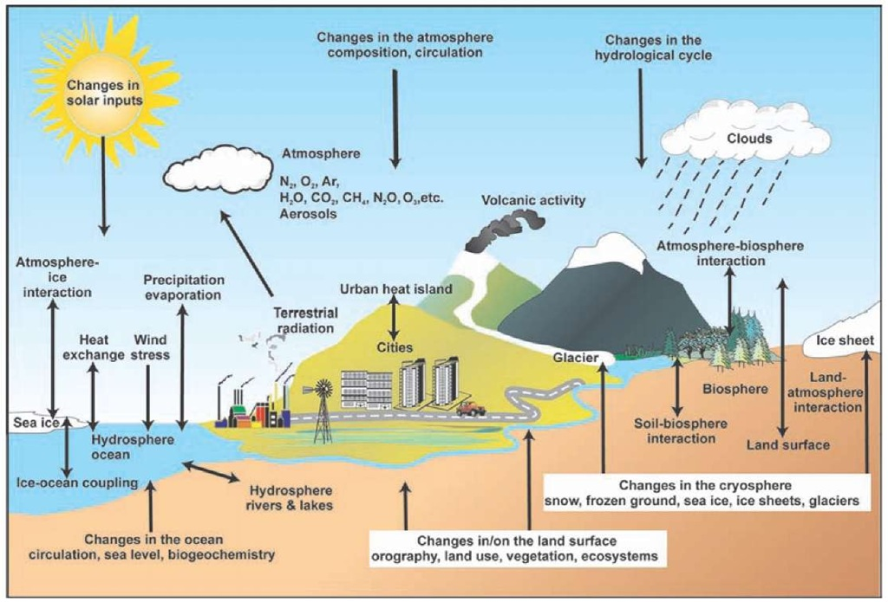
The climate system and global climate change
The elements of the global climate system include the atmosphere, biosphere, hydrosphere, cryosphere, and lithosphere
Greenhouse gases are responsible for an approximately 30 °C elevation of global average surface temperature.
Since the Industrial Revolution, increasing greenhouse gas concentrations due to fossil fuel combustion,
cement-making, land use changes has increased the mean surface temperature of the Earth by approximately an additional 1 °C.

Slide 5
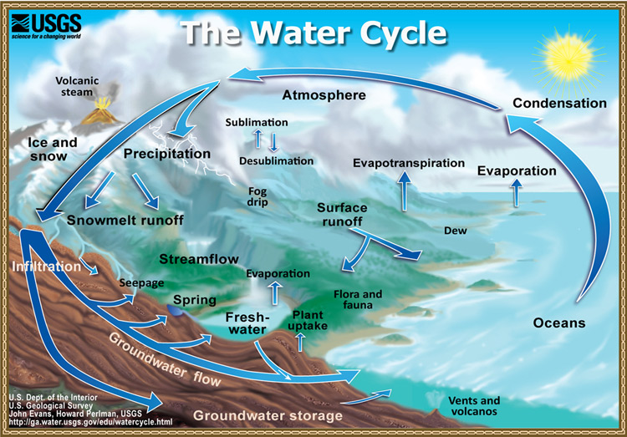
Hydrologic cycle linkage
The hydrologic cycle, also known as the water cycle is a way of describing the material flow of water throughout the Earth.
This series of steps describes how water moves across the Earth and changes form.
These specific steps result in the circulation of water between oceans, the atmosphere, and the land.

Slide 6
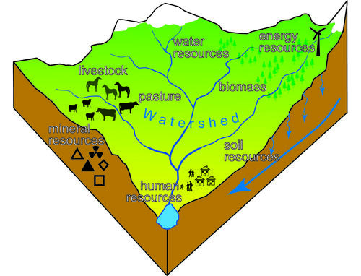
What is it about Watershed?
The watershed is the area of land that drains or sheds water into a specific receiving water body, such as a lake or a river.
Every body of water (e.g., rivers, lakes, ponds, streams, and estuaries) has a watershed.

Slide 7
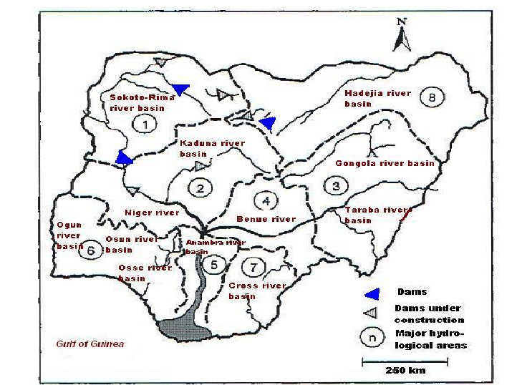
Major Watersheds in Nigeria
Three major watersheds have been identified in Nigeria from which major rivers and streams and their tributaries took their sources.
The North Central Highlands watershed of which the Jos Plateau is the major component.
The Western Uplands of which the Idanre hills is a major component.
3. The Eastern Scarplands of the Udi Plateau is the major component.

Slide 8
Climate Change and Watershed
Changes in the climate regime can influence natural processes of a watershed ecosystem IPCC 2001a and have long-term implications on economic and ecological processes.
A general consensus is that the average global surface temperature has risen by 0.45–0.6°C (0.8–1.0°F) and the average sea level has risen approximately 15–20 cm (6–8 in.) during the last century (IPCC 2001).
This trend of increasing surface temperatures could impact the hydrologic cycle and various processes of a watershed system.
Specific potential impacts include changes in
Runoff,
nutrient enrichment,
sediment loading,
evapotranspiration rates in a watershed system (Band et al. 1996).

Slide 9
Impacts of Climate Change on Watershed Hydrology
The potential effects of a climate change on watershed hydrologic processes and its expected are:
Increased Atmospheric Evaporative Demand (Increased Evapo-transpiration)
Change in Vegetation Composition Affecting Evaporation and Interception
Precipitation Change
Altered Groundwater Storage and Recharge
Change in Stream Flow and runoff Characteristics

Slide 10
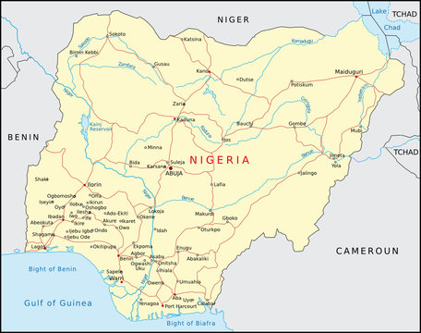
Impacts of Climate Change on Watershed Hydrology – The Nigerian Situation
Nigeria is located between Lat.4º N and Lat. 14º N
Between Latitudes 4º N and 7º N which coincides with the Tropical Rain Forest is characterized by high temperatures, very high evapotranspiration loss, and thick cloud cover resulting in heavy and torrential rains.
Between Latitudes 10º N and 14º N coincides with the Savanna vegetation with moderate to deficient rainfall is characterized by high evaporative loss from the land that is already suffering moisture deficit.

Slide 11
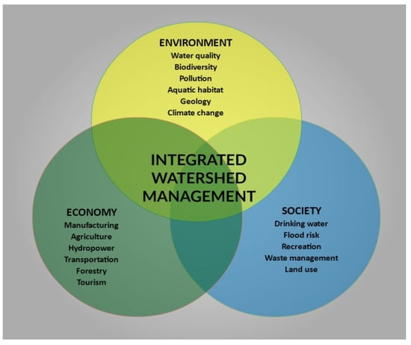
Watershed Management
Major watershed management objectives:
ensuring that beneficial uses of water resources and other related resources are maintained,
avoiding negative off-site impacts (externalities) on water and related resources,
It also helps to promote social and economic growth, to protect, reduce, or repair natural resources and the environment,
reduce local susceptibility to climate extremes, and maintain a balanced biodiversity action

Slide 12
Policy Options
Conclusions
Generally since water is vital for the existence of life and overall process of the planet and is vulnerable to climate change impacts developing and testing probabilistic regional models to understand and predict key impacts of changes in water dynamics under a range of climate scenarios is expedient.
GOALS OF WATERSHED DEVELOPMENT PLANNING AND MANAGEMENT
• To avoid environmental degradation
• To promote sustainable development of the basin.
• To integrate land and water management
• To promote integrated, optimal development of natural resources, agriculture, infrastructure, social services etc.
• To promote rural development.
• To decentralize planning and management and make it adaptive.
• To integrate environmental dimensions with other aspects of planning and management.

Slide 13
Bibliography
Barnett, T.P., Adam, J.C., Lettenmaier, D.P. 2008. Potential impacts of a warming climate on water availability in snow-dominated regions, Nature, 438, 303–309.
Bates, B. C., Kundzewicz, S. W., & Palutikof, J. P. 2008. Climate change and water. Technical paper of the Intergovernmental Panel on Climate Change. Geneva: IPCC Secretariat. (USEPA 2004)
Carpenter S, Fisher S, Grimm N, Kitchell JF (1992) Global change and freshwater ecosystems. Ann Rev Ecolog Syst 23:119–137
IPCC 2007. The physical science basis – summary for Policymakers. Contribution of WG1 to the Fourth assessment report of the Intergovernmental Panel on Climate Change. Available at:http://www.ipcc.ch/ipccreports/ar4- wg1.htm.
IPCC, 2001. Climate Change: The Scientific Basis, Contribution of Working Group I to the Third Assessment Report of the Intergovernmental Panel on Climate Change, edited by: Houghton, J. T., Ding, Y., Griggs, D. J., Noguer, M., van der Linden, P. J., Dai, X., Maskell, K., and Johnson, C. A., Cambridge University Press, Cambridge, UK and New York, NY, USA, 30 Pp. 881.
Intergovernmental Panel on Climate Change (IPCC) (2001a) Climate Change 2001: Impacts, Adaptation, and Vulnerability Contribution of Working Group II to the Third Assessment Report of the Intergovernmental Panel on Climate Change. Cambridge University Press, Cambridge
River Basin Development Authority Act., “An Act to repeal the River Basins Development Authorities Act 1979 and establish the River Basins Development Authorities listed under the First Schedule to the Act”. pp. 3, 1986.
UNESCO & UN Water, 2020. United Nations World Water Development Report 2020: Water and Climate Change. United Nations Educational, Scientific and Cultural Organization, Paris.
UNFCCC, 2007. Climate Change: Impacts, Vulnerabilities and Adaptation in Developing Countries. United Nations Framework Convention on Climate Change.
Water Resources Commission, 2018. Basins. Retrieved October 9, 2018, from. Ghana Water Resources Commission. https://www.wrc-gh.org/basins/densu
WHO/UNICEF (2010). Joint monitoring programme for water supply and sanitation. Meeting the MDG drinking water and sanitation target: mid-term assessment of progress. WHO; Geneva: UNICEF, New York.
WMO 2023 State of the Climate in 2022 Annual Report

