Slide 1
WATER RESOURCES MANAGEMENT IN A TYPICAL CATCHMENT
BY
DIBAL HYELADI USMAN

Slide 2
Quotes
If there is good available water anywhere, there is no need for management of water resources (Dibal)
Take away water from any community and there won’t be peace anywhere (Dibal)

Slide 3
INTRODUCTION
Water Resource
Water resource is the entire range of natural waters that occur on earth, regardless of their state (vapour, liquid or solid) and are potentially useful to humans.
Management
Management is a distinct process consisting of planning, organizing, actuating and controlling; followed to accomplish pre-determined objectives
Catchment
A catchment is a geographical area where precipitation collects and drains into an outlet such as a river, or lake. A catchment could both be small (local river) or large scale (large river)

Slide 4
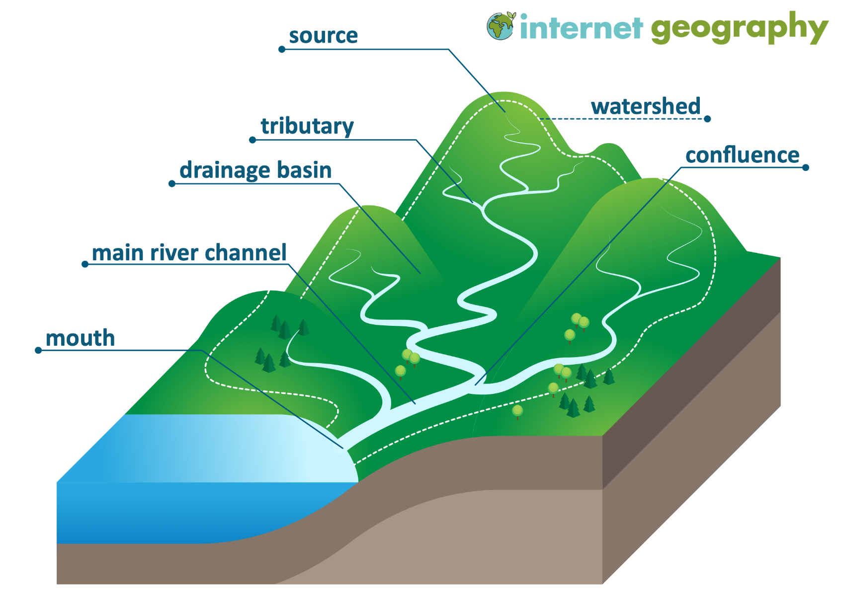
Fig 1: A typical catchment area

Slide 5
CHARACTERISTICS OF A TYPICAL CATCHMENT
A typical catchment have the following characteristics
1. Size
2. Topography
3. Land use
4. Climate
5. Component of the Hydrological Cycle expressed as P = I + R + E
Where P = precipitation
I = infiltration
R = surface runoff
E = evapotranspiration

Slide 6
WATER RESOURCES IN A CATCHMENT
1. Surface (rivers, streams, lakes, ponds)
2. Groundwater (this could be developed in the form of hand-dug wells, hand pumps, and boreholes)
3. Rainwater Harvesting in some places

Slide 7
THE BIG QUESTION:
Why is water not available?
1. Population growth
2. Climate change (rise in temperature, flooding, drought etc)
3. Competition.
These have affected availability and quality of water and the eco-system all over the world.

Slide 8
WATER DEMAND AND ALLOCATION
I. Domestic
II. Agricultural (irrigation and livestock)
III. Industrial
IV. Recreational
V. Mining

Slide 9
CRITICAL PARAMETERS IN THE MANAGEMENT OF WATER IN A TYPICAL CATCHMENT
Location and geography of the catchment or river basin
Drainage
Relief
Population and land use
Geology
Morphometry
Aquifer characteristics
Groundwater movement
Stream flow and discharges

Slide 10
MORPHOMETRIC ANALYSIS OF THE CATCHMENT OR DRAINAGE BASIN
a. Determine the stream number and order (Horton, 1945; Strahler, 1964
b. The average length of the stream of each order
c. The slope or gradient of the stream of each order
d. The drainage basin area for the stream of each order
The morphometric analysis of the catchment is defined by

Slide 11
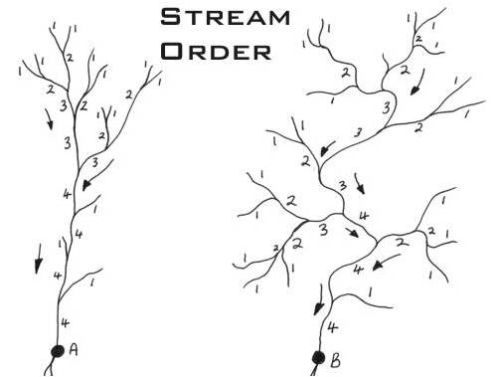
Fig 2: Stream order

Slide 12
- Form of the basin
- Shape of the basin
- Circulatory ratio
- Elongation

Slide 13
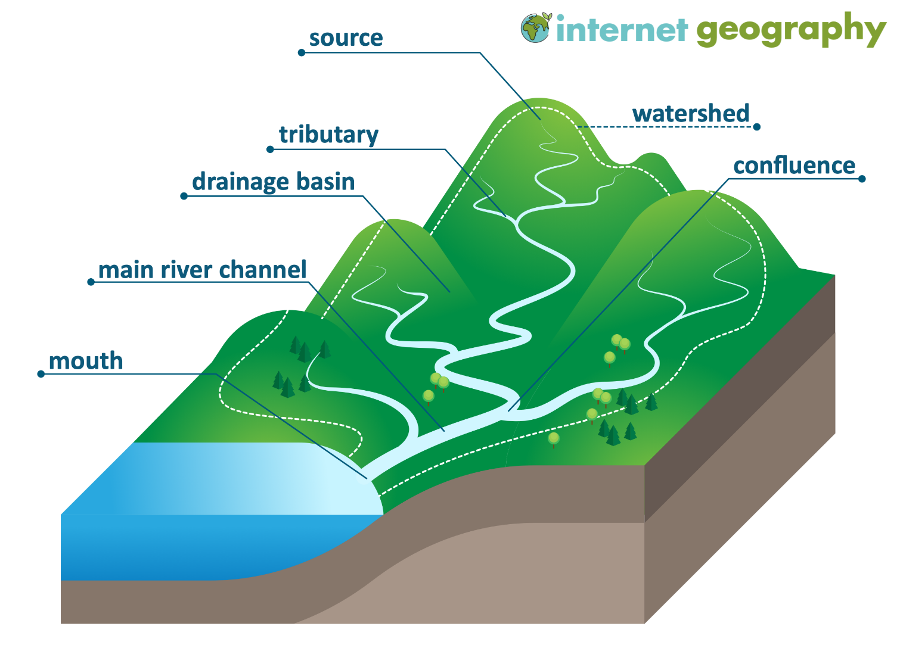

Slide 14
AQUIFER CHARACTERISTICS
The Aquifer Characteristics Are:
Thickness of the aquifer
Hydraulic conductivity
Transmissivity
Yield of the aquifer

Slide 15
GROUNDWATER MOVEMENT
This is achieved by monitoring groundwater levels in open wells or boreholes over a period of time by measuring depth to water.
Data obtained from such monitoring are used to plot groundwater flowlines from which the direction of groundwater flows is determined.
Flow nets are then constructed.
Compartments of flow tubes are determined according to areas
In conjunction with pumping test data flow within tubes in areas can be used to determine flow over the area per day and up to a year

Slide 16
STREAM FLOW AND DISCHARGES
Determination of river discharges (several methods such as;
Weir/ stage stations/construction of artificial stream channels,
measure of river velocity and cross sectional area
Float velocity
Measurement of velocity by dilution.

Slide 17
WATER BUDGET
Available resources (surface and groundwater) are calculated based on the population and their water demand per head for various purposes.
Critical to the World Bank in developing nations is the domestic and agricultural needs. This is not to say that other needs are not important

Slide 18
DETERMINATION OF QUALITY OF WATER
Field Parameters (Physical)
- Colour
- Odour
- Taste
- Temperature,
- pH
- Total Dissolved Solids
- Electrical Conductivity
- Alkalinity (CaCO3)
- Dissolved Oxygen,
- Eh (Oxidation Reduction Potential of Water)

Slide 19
LABORATORY ANALYSIS OF WATER SAMPLES:
1. Major cations (Na, K, Mg and Ca – Inductively Coupled Plasma Optical Emission Spectrophotometer or Atomic Absorption Spectrophotometer best methods)
2.The anions (HCO₃, Cl, SO₄ NO_{3,} F – Ion Chromatography best method for the analysis)
3. Trace elements (Al, Cd, Fe, Cr, Pb etc)
4. Microbiological content – Membrane filtration

Slide 20
MODELLING OF SOME PARAMETERS CRITICAL FOR WATER QUALITY
Sodium Absorption Ratio
Salinity Hazard
Magnesium Hazard
Exchangeble Sodium Ratio
Residual Sodium Concentration
Hardness
Water Type

Slide 21
CASE STUDY OF WATER QUALITY FOR LANGTANG, PLATEAU STATE
The catchment selected for the case study is Langtang in Plateau State.
Langtang is located in the southern part of Plateau State.
It has a population of 142,316 and projected population of 209,400 by 2022 (NPC, 2006)
The drainage is dendritic.

Slide 22
Three rivers drain the area, two of which has been impounded.
The major rock types are Porphyritic biotite granite which underlain the area with intrusions of medium grained biotite granites, rhyolite, and trachyte.
Sources of water are from rivers, streams, dam and hand dug wells and hand pumps.
The aquifers are the river alluvium, weathered Overburden and fractured aquifer.
It has temperature of 27 – 33^{O}C
The terrain is flat in the east and hilly in the west, where the rivers and the streams originate.

Slide 23
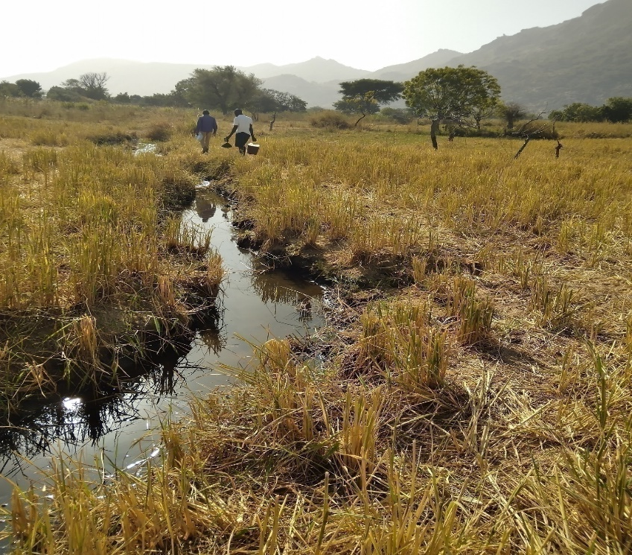
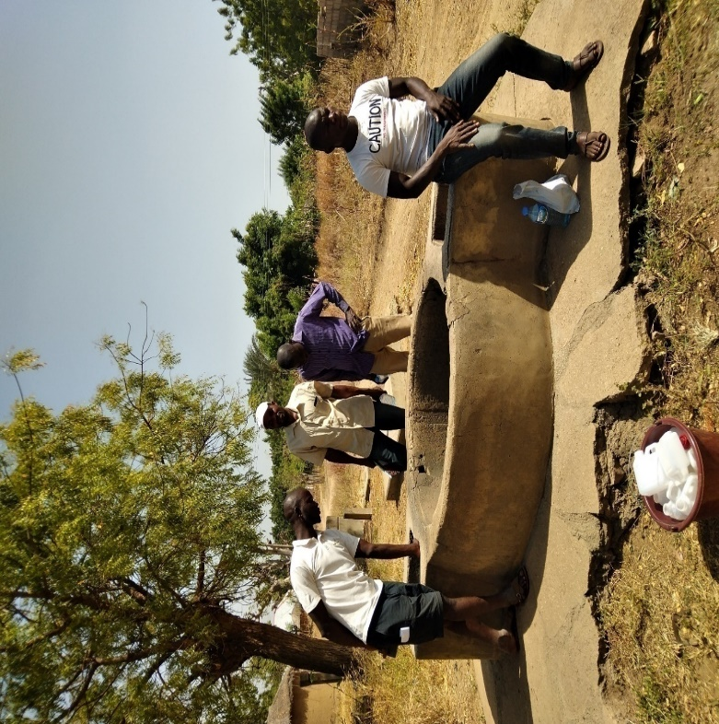
Plate I: The Chalyat stream. Further away are the medium grained biotite granite Hills
Plate II: A typical opened hand dug well at Langtang. The well is over 50 years old, with a total depth of 15 m and depth to water of 10 meters.

Slide 24
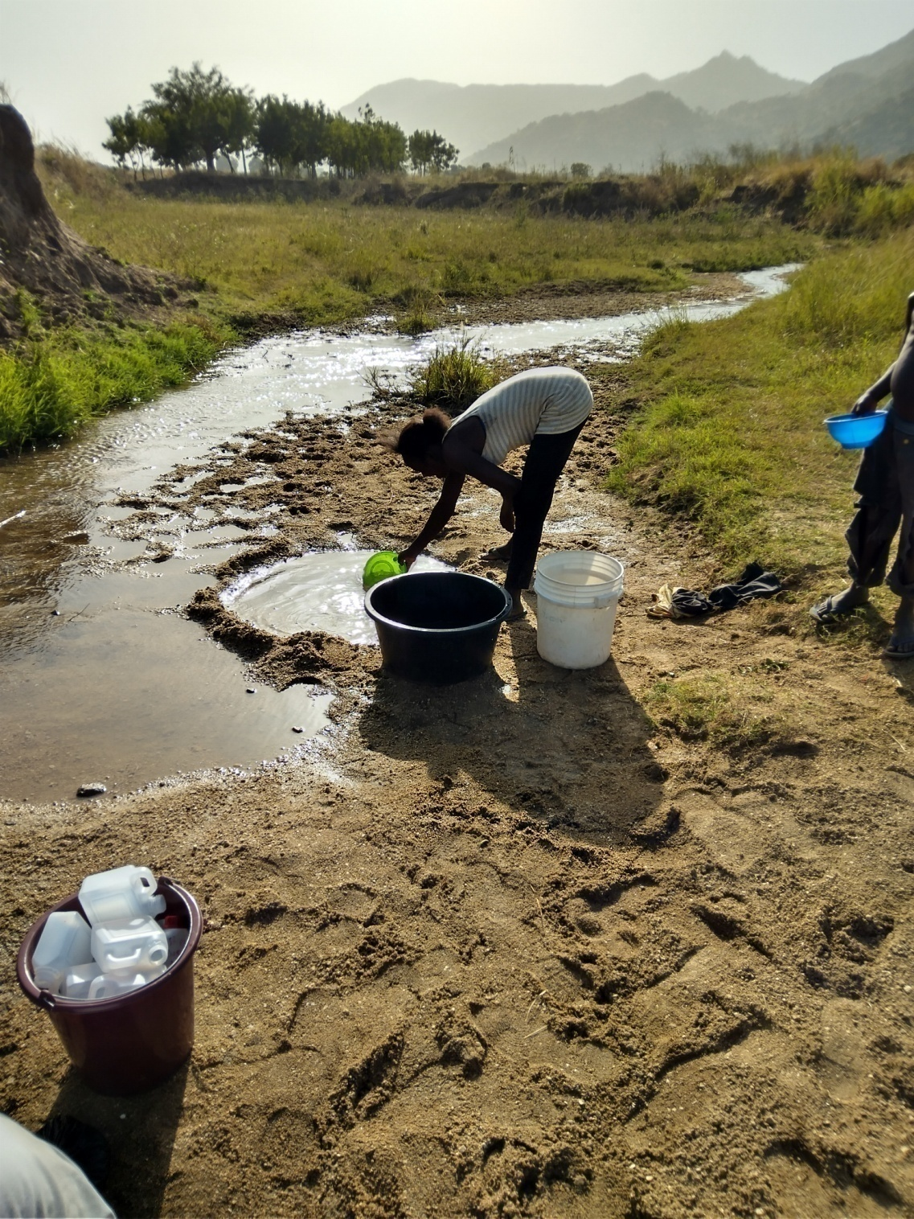
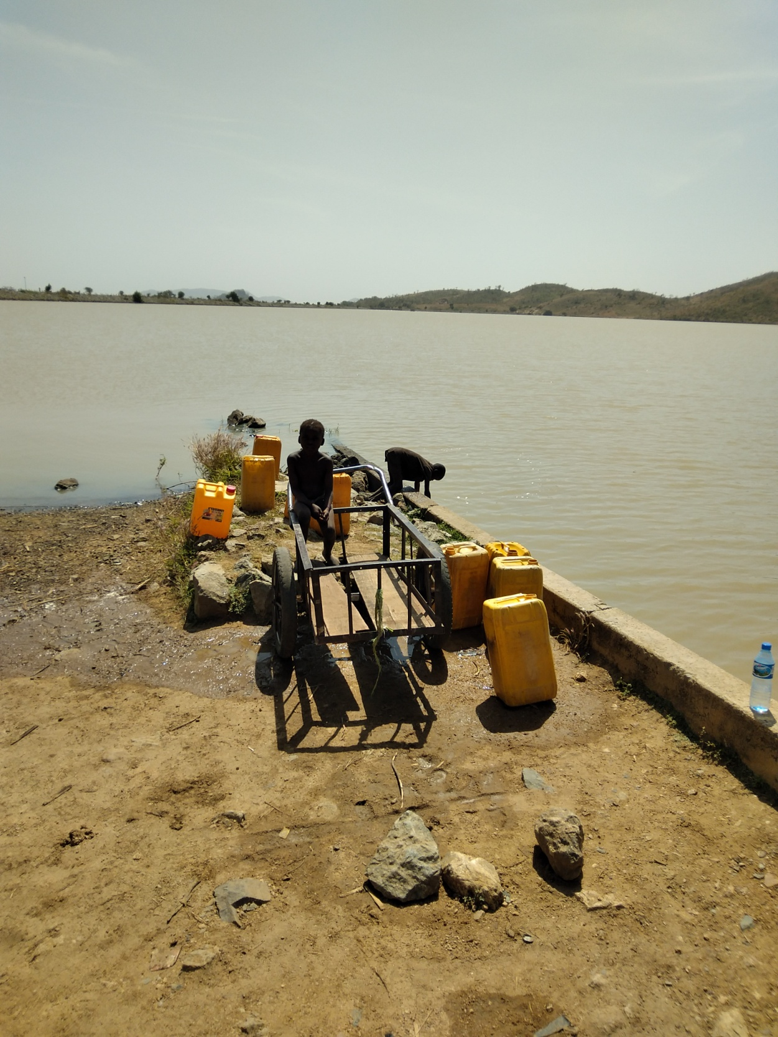
Plate III: A river alluvium which serve as aquifer in the dry season
Plate IV: The Langtang Dam. The rhyolite hills at flank

Slide 25
Table 1: Microbiological Content of Water Sources in Langtang
Source of water | No of Samples | Range in Plate Count | Coliform Count (Cfu/ml) | Isolates
River | 8 | 9 - 93 | 1 - 19 | Proteus Spp. Staphylococcus Aureus. E. Coli and Baccilus Spp. E. coli is common in the rivers
Stream | 8 | 39 - 69 | 22 - 42 | E.coli, Staphylococcus aureus and Proteus Spp. E. coli common to all sources
Hand Dug well | 4 | 6 - 51 | 3 - 29 | Staphylococcus aureus, E. coli, Proteus Spp., Bacilus Spp and Salmonella Typhi. Staph. Aureus common in all sources
Hand Pump | 1 | 75 | 71 | E. coli
Dam | 6 | 5 - 43 | 1 - 32 | Staphylococcus aureus, E. coli, Baccilus Spp., Pseudomonas aeruginosa.
WHO/NSDWQ |  |  | 0Cfu/ml/10Cfu/ml

Slide 26
Field Parameters of Water Sources
Water source | No of sample | pH | Temp (^{O}C) | TDS (PPM) | EC (µs/cm)
River | 8 | 7.03 – 7.74 | 20.60 – 34.40 | 41.00 - 47.00 | 82.00 – 84.00
Stream | 8 | 7.10 – 7.57 | 27.56 – 35.80 | 51.00 – 78.00 | 120.00 – 156.00
Hand Dug well | 4 | 7.36 – 7.51 | 31.80 - 32.50 | 65.00 – 239.00 | 130.0 – 478.00
Hand Pump | 1 | 7.50 | 31.00 | 182.00 | 365.00
Dam | 6 | 7.22 – 7.62 | 27.60 – 32.50 | 42.00 – 80.00 | 84.00 – 160.00
WHO/NSDWQ |  | 6.0 – 8.0 | Ambient | 500 - 1000

Slide 27
Chemical Prameters (Anions – ppm) of Waters in some of the Sources
Water source | No of sample | Cl | SO₄ | NO₃ | Alkalinity
River | 8 | 15.00-20.00 | 1.00-91.25 | 5.85-18.00 | 80.00-100.00
Stream | 8 | 15.00-20.00 | 5.80-22.56 | 9.00-27.00 | 120.00-140.00
Hand Dug well | 4 | 15.00-55.00 | 3.76-15.20 | 9.00-67.00 | 180-260.00
Hand Pump | 1
Dam | 6 | 9.00-15.00 | 2.00-19.00 | 9.00-27.00 | 100.00-120.00
WHO/NSDWQ |  | 250 | 250 | 45

Slide 28
Major Cations (ppm) in some water sources in Langtang.
Water source | No of sample |  | Na | _{Ca} | _{Mg} | K
River | River | 3 | 8.09-12.83 | 3.97-18.84 | 0.62-3.46 | 1.23-2.84
Stream | Stream | 1 | 13.35 | 13.70 | 2.73 | 1.03
Hand Dug well | Hand Dug well | 1 | 16.64 | 22.00 | 4.68 | 1.02
Hand Pump | Hand Pump
Dam | Dam | 2 | 8.00-11.84 | 9.31-16.45 | 1.73-3.62 | 1.81-2.29
WHO/NSDWQ | WHO/NSDWQ |  | 200 | 150 - 200

Slide 29
Concentration of Trace Elements (ppm) in some water sources in Langtang
Water source | No of sample | Cd | _{Cr} | _{Pb} | Ni
River | 4 | 0.51 – 0.52 | 0.02 – 0.05 | BDL | 0,12 – 0.14
Stream | 6 | 0.06 – 0.35 | 0.01 – 0.05 | BDL | 0.01 – 0.09
Hand Dug well | 1 | 0.43 | 0.06 | BDL | 0.14
Hand Pump | - | - | - | - | -
Dam | 2
WHO/NSDWQ |  | 0.05 | 0.003 | 0.01 | 0.007

Slide 30
Requirements for Irrigation Waters in Langtang
Sample ID | Salinity Hazard | SAR | ESR | Magnesium Hazard | RSC
LGT 02 (River) | Low | 0.007 | 0.456 | 23.2 | 0.00
LGT03 (River) | Low | 0.008 | 0.648 | 23.9 | 0.07
LGT 04 (Hand Dug Well) | Low | 0.008 | 0.488 | 26.0 | 0.01
LGT 05 (Stream) | Low | 0.009 | 0.639 | 24.7 | 0.00
LGT 08 (Stream) | Low | 0.007 | 0.465 | 29.9 | 0.00
LGT 18 (Dam) | Low | 0.006 | 0.573 | 23.5 | 0.00
LGT 19 (Dam) | Low | 0.007 | 0.460 | 26.6 | 0.08
LGT 26 (Hand Dug Well) | Low | 0.100 | 1.412 | 20.5 | 0.00

Slide 31
MANAGING THE AVAILABLE WATER RESOURCES IN A CATCHMENT
Adopt the concept of Integrated Water Resources Management which involves:
1. Stakeholders participation
2. Water Governance and Policy
3. Integration of social, economic and environmental considerations.
Water Conservation and Efficiency
1. Practice efficient irrigation
2. Water saving technology
3. Create public awareness

Slide 32
Managing the available water resources in a catchment
Water Efficiency
In our demand for water for various purposes, water we should
1. re-use water
2. Harvest waters from rain
3. Be diligent to detect leakages underground

Slide 33
MANAGING THE AVAILABLE WATER RESOURCES IN A CATCHMENT
Flood Management and Drought Mitigation Strategies.
- This could be achieved through river channelization
- Flood plain zoning
- Build flood control structures.
Drought could be mitigated through
- Water storage facilities
- Groundwater recharge
- Planting of drought resistant plants

Slide 34
CONCLUSION
Everyday water is needed for various purposes, which is readily not available. The effect of climate change and population growth has compounded the problem. The World Bank spends billions of dollars in developing nations to provide these limited resources to communities to encourage healthy leaving and food sufficiency. There is therefore the need to practice efficient use of water to meet the need of the next generation

